Slide 1
Academy, Fountain Park, Lewis Place Place, Vandeventer
Monthly Crime report: January 2020 Washington University Medical Center

Slide 2
Academy: Summary Notes
9 total crimes in January 2020
-59.1% change compared to January 2019 (22 total crimes)
3 crime(s) against persons in January 2020
-62.5% change compared to January 2019 (8 crimes against persons)
9 total crimes in 2020
-59.1% change compared to this time in 2019 (22 total crimes)
3 crime(s) against persons in 2020
-62.5% change compared to this time in 2019 (8 crimes against persons)

Slide 3
Academy: Year to Year Comparison
Part 1 Crimes | Jan | Feb | Mar | Apr | May | Jun | Jul | Aug | Sep | Oct | Nov | Dec | Total
Aggravated Assault | 8 | 7 | 4 | 3 | 2 | 4 | 3 | 5 | 8 | 2 | 0 | 6 | 52
Arson | 0 | 1 | 0 | 0 | 0 | 0 | 1 | 0 | 0 | 4 | 0 | 1 | 7
Burgalry | 5 | 3 | 1 | 2 | 1 | 1 | 3 | 4 | 1 | 3 | 0 | 4 | 28
Homicide | 0 | 0 | 0 | 0 | 0 | 0 | 0 | 1 | 0 | 1 | 0 | 0 | 2
Larceny | 7 | 4 | 5 | 8 | 7 | 8 | 9 | 10 | 11 | 11 | 9 | 6 | 95
Motor Vehicle Theft | 2 | 1 | 0 | 1 | 1 | 4 | 4 | 2 | 1 | 3 | 2 | 3 | 24
Robbery | 0 | 1 | 2 | 2 | 2 | 0 | 0 | 5 | 2 | 1 | 1 | 0 | 16
Total | 22 | 17 | 12 | 16 | 13 | 17 | 20 | 27 | 23 | 25 | 12 | 20 | 224
Part 1 Crimes | Jan | Total
Aggravated Assault | 2 | 2
Arson | 0 | 0
Burgalry | 2 | 2
Homicide | 0 | 0
Larceny | 2 | 2
Motor Vehicle Theft | 2 | 2
Robbery | 1 | 1
Total | 9 | 9

Slide 4
Academy: Summary Tables
Part 1 Crimes | Number of Crimes
Aggravated Assault | 2
Burgalry | 2
Larceny | 2
Motor Vehicle Theft | 2
Robbery | 1
Total | 9
Day of the Week | Number of Crimes
Sun | 1
Mon | 3
Tue | 1
Wed | 0
Thu | 2
Fri | 2
Sat | 0
Total | 9
Crimes Against Persons | Number of Crimes
FALSE | 6
TRUE | 3
Total | 9
Time of Day | Number of Crimes
Day | 8
Night | 1
Total | 9

Slide 5
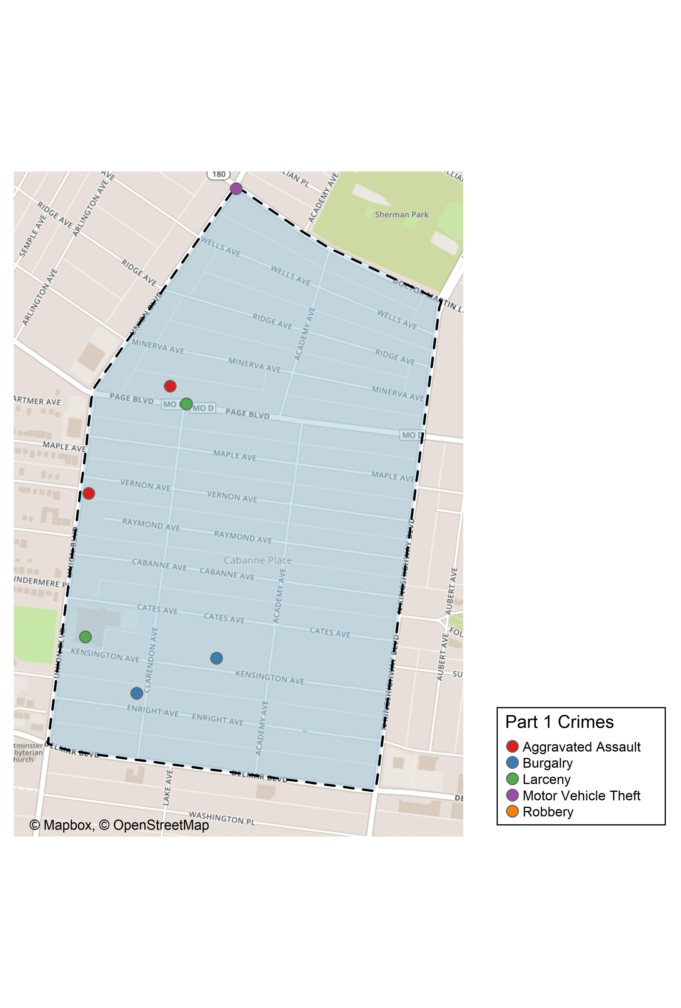
Academy: Total Crime Map

Slide 6
Fountain Park: Summary Notes
6 total crimes in January 2020
-62.5% change compared to January 2019 (16 total crimes)
3 crime(s) against persons in January 2020
-50.0% change compared to January 2019 (6 crimes against persons)
6 total crimes in 2020
-62.5% change compared to this time in 2019 (16 total crimes)
3 crime(s) against persons in 2020
-50.0% change compared to this time in 2019 (6 crimes against persons)

Slide 7
Fountain Park: Year to Year Comparison
Part 1 Crimes | Jan | Feb | Mar | Apr | May | Jun | Jul | Aug | Sep | Oct | Nov | Dec | Total
Aggravated Assault | 5 | 3 | 11 | 3 | 0 | 3 | 8 | 3 | 7 | 5 | 3 | 0 | 51
Arson | 0 | 0 | 0 | 1 | 0 | 0 | 0 | 1 | 0 | 0 | 0 | 0 | 2
Burgalry | 3 | 2 | 1 | 0 | 2 | 0 | 2 | 2 | 2 | 0 | 3 | 1 | 18
Homicide | 0 | 1 | 1 | 0 | 0 | 0 | 1 | 0 | 0 | 1 | 0 | 0 | 4
Larceny | 4 | 5 | 6 | 5 | 2 | 5 | 6 | 7 | 10 | 3 | 3 | 1 | 57
Motor Vehicle Theft | 3 | 0 | 4 | 1 | 0 | 2 | 2 | 0 | 2 | 1 | 0 | 0 | 15
Robbery | 1 | 0 | 0 | 2 | 0 | 3 | 1 | 5 | 0 | 2 | 1 | 1 | 16
Total | 16 | 11 | 23 | 12 | 4 | 13 | 20 | 18 | 21 | 12 | 10 | 3 | 163
Part 1 Crimes | Jan | Total
Aggravated Assault | 2 | 2
Arson | 0 | 0
Burgalry | 0 | 0
Homicide | 1 | 1
Larceny | 2 | 2
Motor Vehicle Theft | 0 | 0
Robbery | 1 | 1
Total | 6 | 6

Slide 8
Fountain Park: Summary Tables
Part 1 Crimes | Number of Crimes
Aggravated Assault | 2
Homicide | 1
Larceny | 2
Robbery | 1
Total | 6
Day of the Week | Number of Crimes
Sun | 0
Mon | 0
Tue | 0
Wed | 3
Thu | 1
Fri | 2
Sat | 0
Total | 6
Crimes Against Persons | Number of Crimes
FALSE | 2
TRUE | 4
Total | 6
Time of Day | Number of Crimes
Day | 6
Total | 6

Slide 9
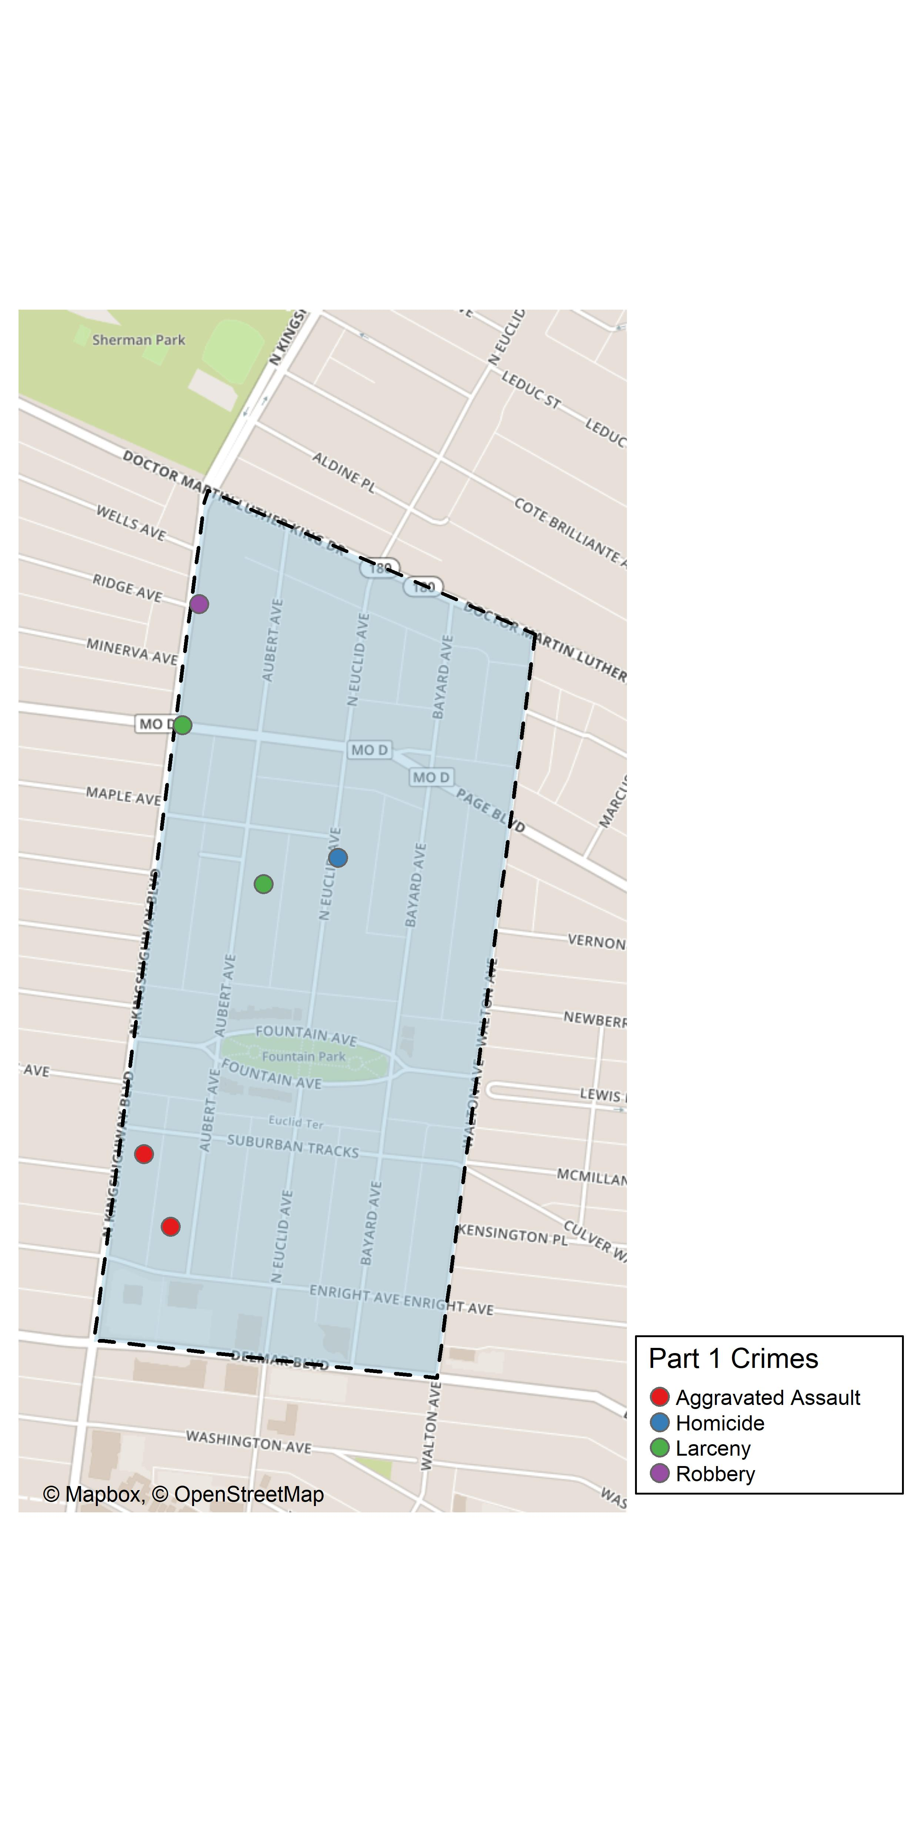
Fountain Park: Total Crime Map

Slide 10
Summary Notes: Lewis Place
5 total crimes in January 2020
0% change compared to January 2019 (5 total crimes)
3 crime(s) against persons in January 2020
-50.0% change compared to January 2019 (6 crimes against persons)
5 total crimes in 2020
0% change compared to this time in 2019 (5 total crimes)
3 crime(s) against persons in 2020
-50.0% change compared to this time in 2019 (6 crimes against persons)

Slide 11
Lewis Place: Year to Year Comparison
Part 1 Crimes | Jan | Feb | Mar | Apr | May | Jun | Jul | Aug | Sep | Oct | Nov | Dec | Total
Aggravated Assault | 0 | 3 | 2 | 3 | 13 | 1 | 2 | 0 | 5 | 4 | 0 | 6 | 39
Arson | 0 | 1 | 0 | 0 | 1 | 0 | 0 | 0 | 0 | 0 | 0 | 0 | 2
Burgalry | 0 | 1 | 0 | 1 | 0 | 1 | 2 | 4 | 0 | 2 | 4 | 1 | 16
Homicide | 0 | 0 | 1 | 1 | 2 | 0 | 3 | 0 | 0 | 0 | 0 | 0 | 7
Larceny | 5 | 2 | 3 | 6 | 3 | 5 | 4 | 2 | 2 | 5 | 0 | 4 | 41
Motor Vehicle Theft | 0 | 1 | 2 | 1 | 1 | 1 | 0 | 1 | 5 | 1 | 1 | 3 | 17
Robbery | 0 | 0 | 0 | 0 | 1 | 0 | 1 | 1 | 1 | 0 | 0 | 1 | 5
Total | 5 | 8 | 8 | 12 | 21 | 8 | 12 | 8 | 13 | 12 | 5 | 15 | 127
Part 1 Crimes | Jan | Total
Aggravated Assault | 0 | 0
Arson | 0 | 0
Burgalry | 0 | 0
Homicide | 1 | 1
Larceny | 2 | 2
Motor Vehicle Theft | 2 | 2
Robbery | 0 | 0
Total | 5 | 5

Slide 12
Lewis Place: Summary Tables
Part 1 Crimes | Number of Crimes
Homicide | 1
Larceny | 2
Motor Vehicle Theft | 2
Total | 5
Day of the Week | Number of Crimes
Sun | 0
Mon | 1
Tue | 0
Wed | 2
Thu | 0
Fri | 1
Sat | 1
Total | 5
Crimes Against Persons | Number of Crimes
FALSE | 4
TRUE | 1
Total | 5
Time of Day | Number of Crimes
Day | 5
Total | 5

Slide 13
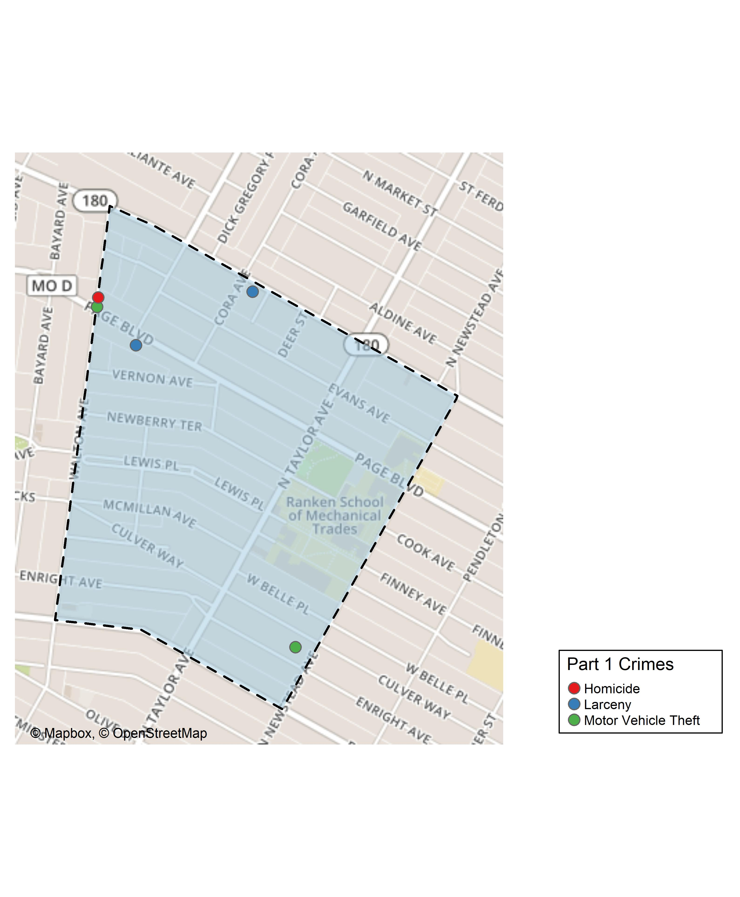
Lewis Place: Total Crime Map

Slide 14
Vandeventer: Summary Notes
12 total crimes in January 2020
100% change compared to January 2019 (6 total crimes)
1 crime(s) against persons in January 2020
Inf change compared to January 2019 (0 crimes against persons)
12 total crimes in 2020
100% change compared to this time in 2019 (6 total crimes)
1 crime(s) against persons in 2020
Inf change compared to this time in 2019 (0 crimes against persons)

Slide 15
Vandeventer: Year to Year Comparison
Part 1 Crimes | Jan | Feb | Mar | Apr | May | Jun | Jul | Aug | Sep | Oct | Nov | Dec | Total
Aggravated Assault | 0 | 2 | 6 | 2 | 4 | 0 | 1 | 3 | 1 | 3 | 0 | 2 | 24
Arson | 0 | 1 | 0 | 0 | 0 | 0 | 0 | 0 | 0 | 0 | 0 | 0 | 1
Burgalry | 1 | 2 | 5 | 3 | 5 | 4 | 3 | 1 | 2 | 3 | 5 | 2 | 36
Homicide | 0 | 0 | 1 | 0 | 0 | 0 | 0 | 0 | 0 | 0 | 0 | 0 | 1
Larceny | 5 | 2 | 3 | 5 | 4 | 5 | 14 | 13 | 17 | 6 | 9 | 7 | 90
Motor Vehicle Theft | 0 | 2 | 1 | 0 | 0 | 2 | 1 | 3 | 1 | 1 | 1 | 0 | 12
Robbery | 0 | 0 | 1 | 0 | 1 | 4 | 0 | 0 | 1 | 2 | 1 | 1 | 11
Total | 6 | 9 | 17 | 10 | 14 | 15 | 19 | 20 | 22 | 15 | 16 | 12 | 175
Part 1 Crimes | Jan | Total
Aggravated Assault | 0 | 0
Arson | 0 | 0
Burgalry | 2 | 2
Homicide | 0 | 0
Larceny | 8 | 8
Motor Vehicle Theft | 1 | 1
Robbery | 1 | 1
Total | 12 | 12

Slide 16
Vandeventer: Summary Tables
Part 1 Crimes | Number of Crimes
Burgalry | 2
Larceny | 8
Motor Vehicle Theft | 1
Robbery | 1
Total | 12
Day of the Week | Number of Crimes
Sun | 2
Mon | 2
Tue | 1
Wed | 1
Thu | 2
Fri | 2
Sat | 2
Total | 12
Crimes Against Persons | Number of Crimes
FALSE | 11
TRUE | 1
Total | 12
Time of Day | Number of Crimes
Day | 12
Total | 12

Slide 17
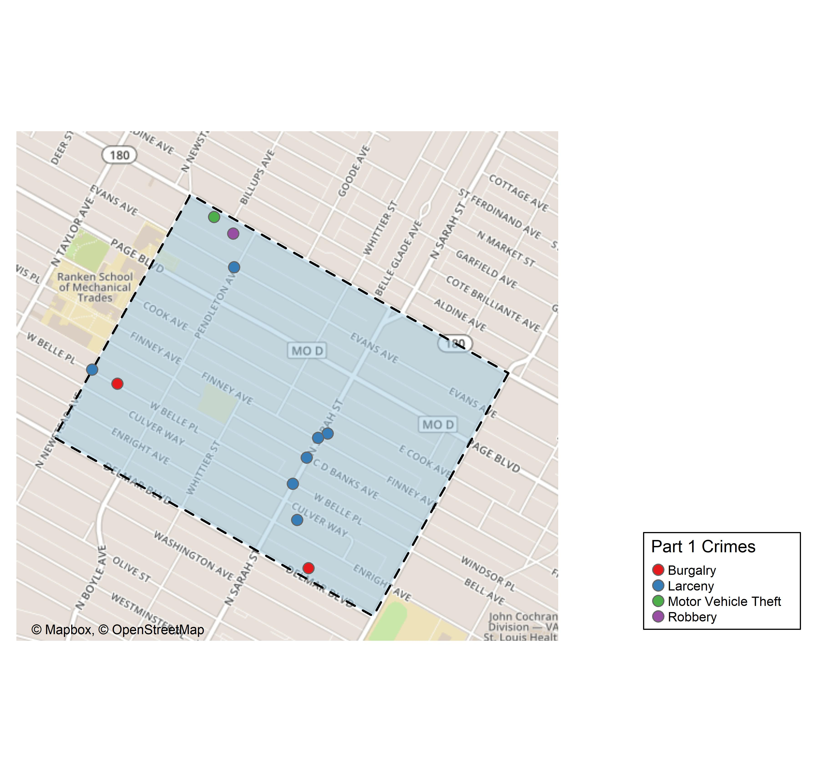
Vandeventer: Total Crime Map

Slide 18
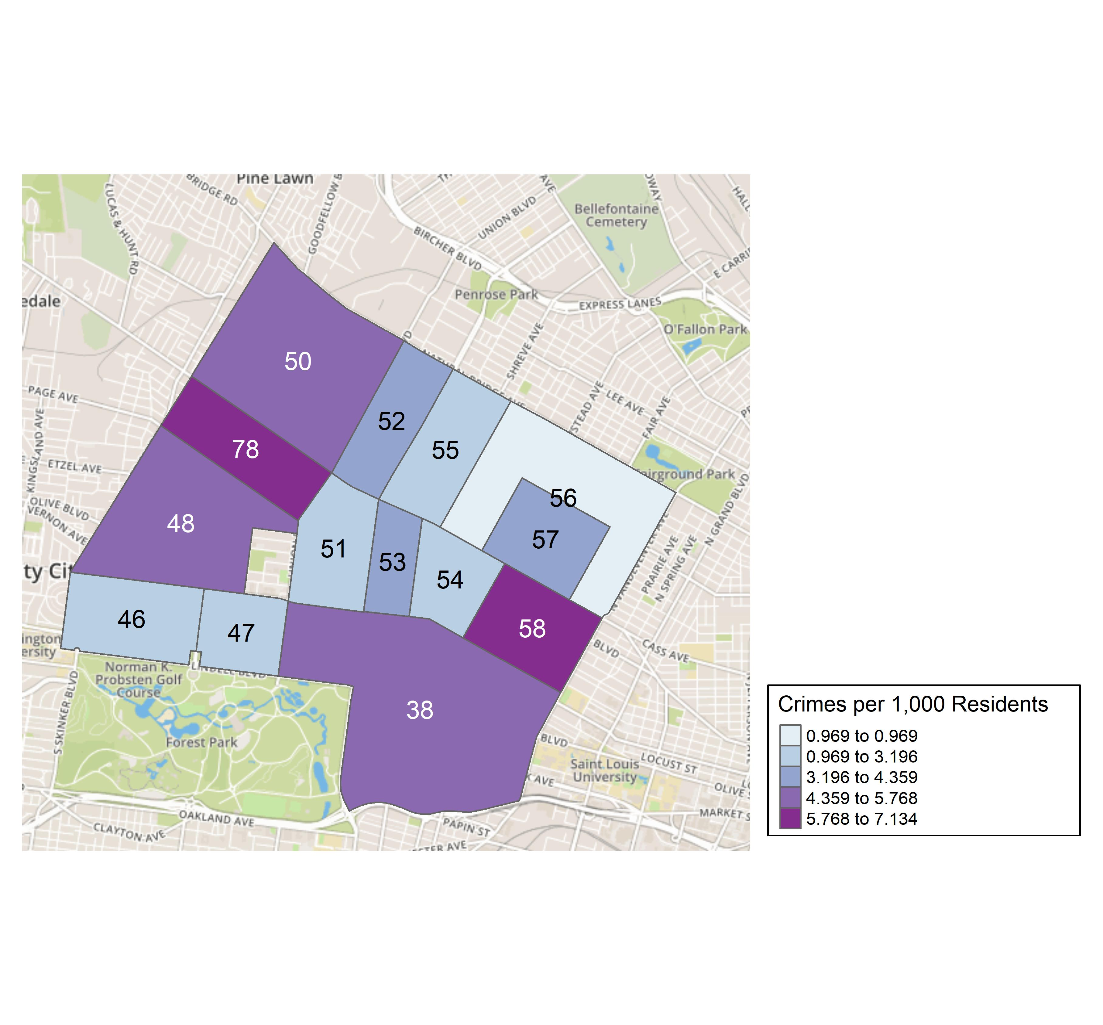
District 5: Crime Rates Map

Slide 19
District 5: Density Map Explanation
There are 15 neighborhoods in District 5.
The minimum number of crimes in one neighborhood was 5 (Lewis Place)
The maximum number of crimes in one neighborhood was 75 (Central West End)
The mean number of crimes in one neighborhood was 18.29
The minimum rate of crimes in one neighborhood was 0.97 (Greater Ville)
The maximum rate of crimes in one neighborhood was 7.13 (Vandeventer)
The mean rate of crimes in one neighborhood was 4.13

Slide 20
Academy: Neighborhood Detail
Appendix 1

Slide 21
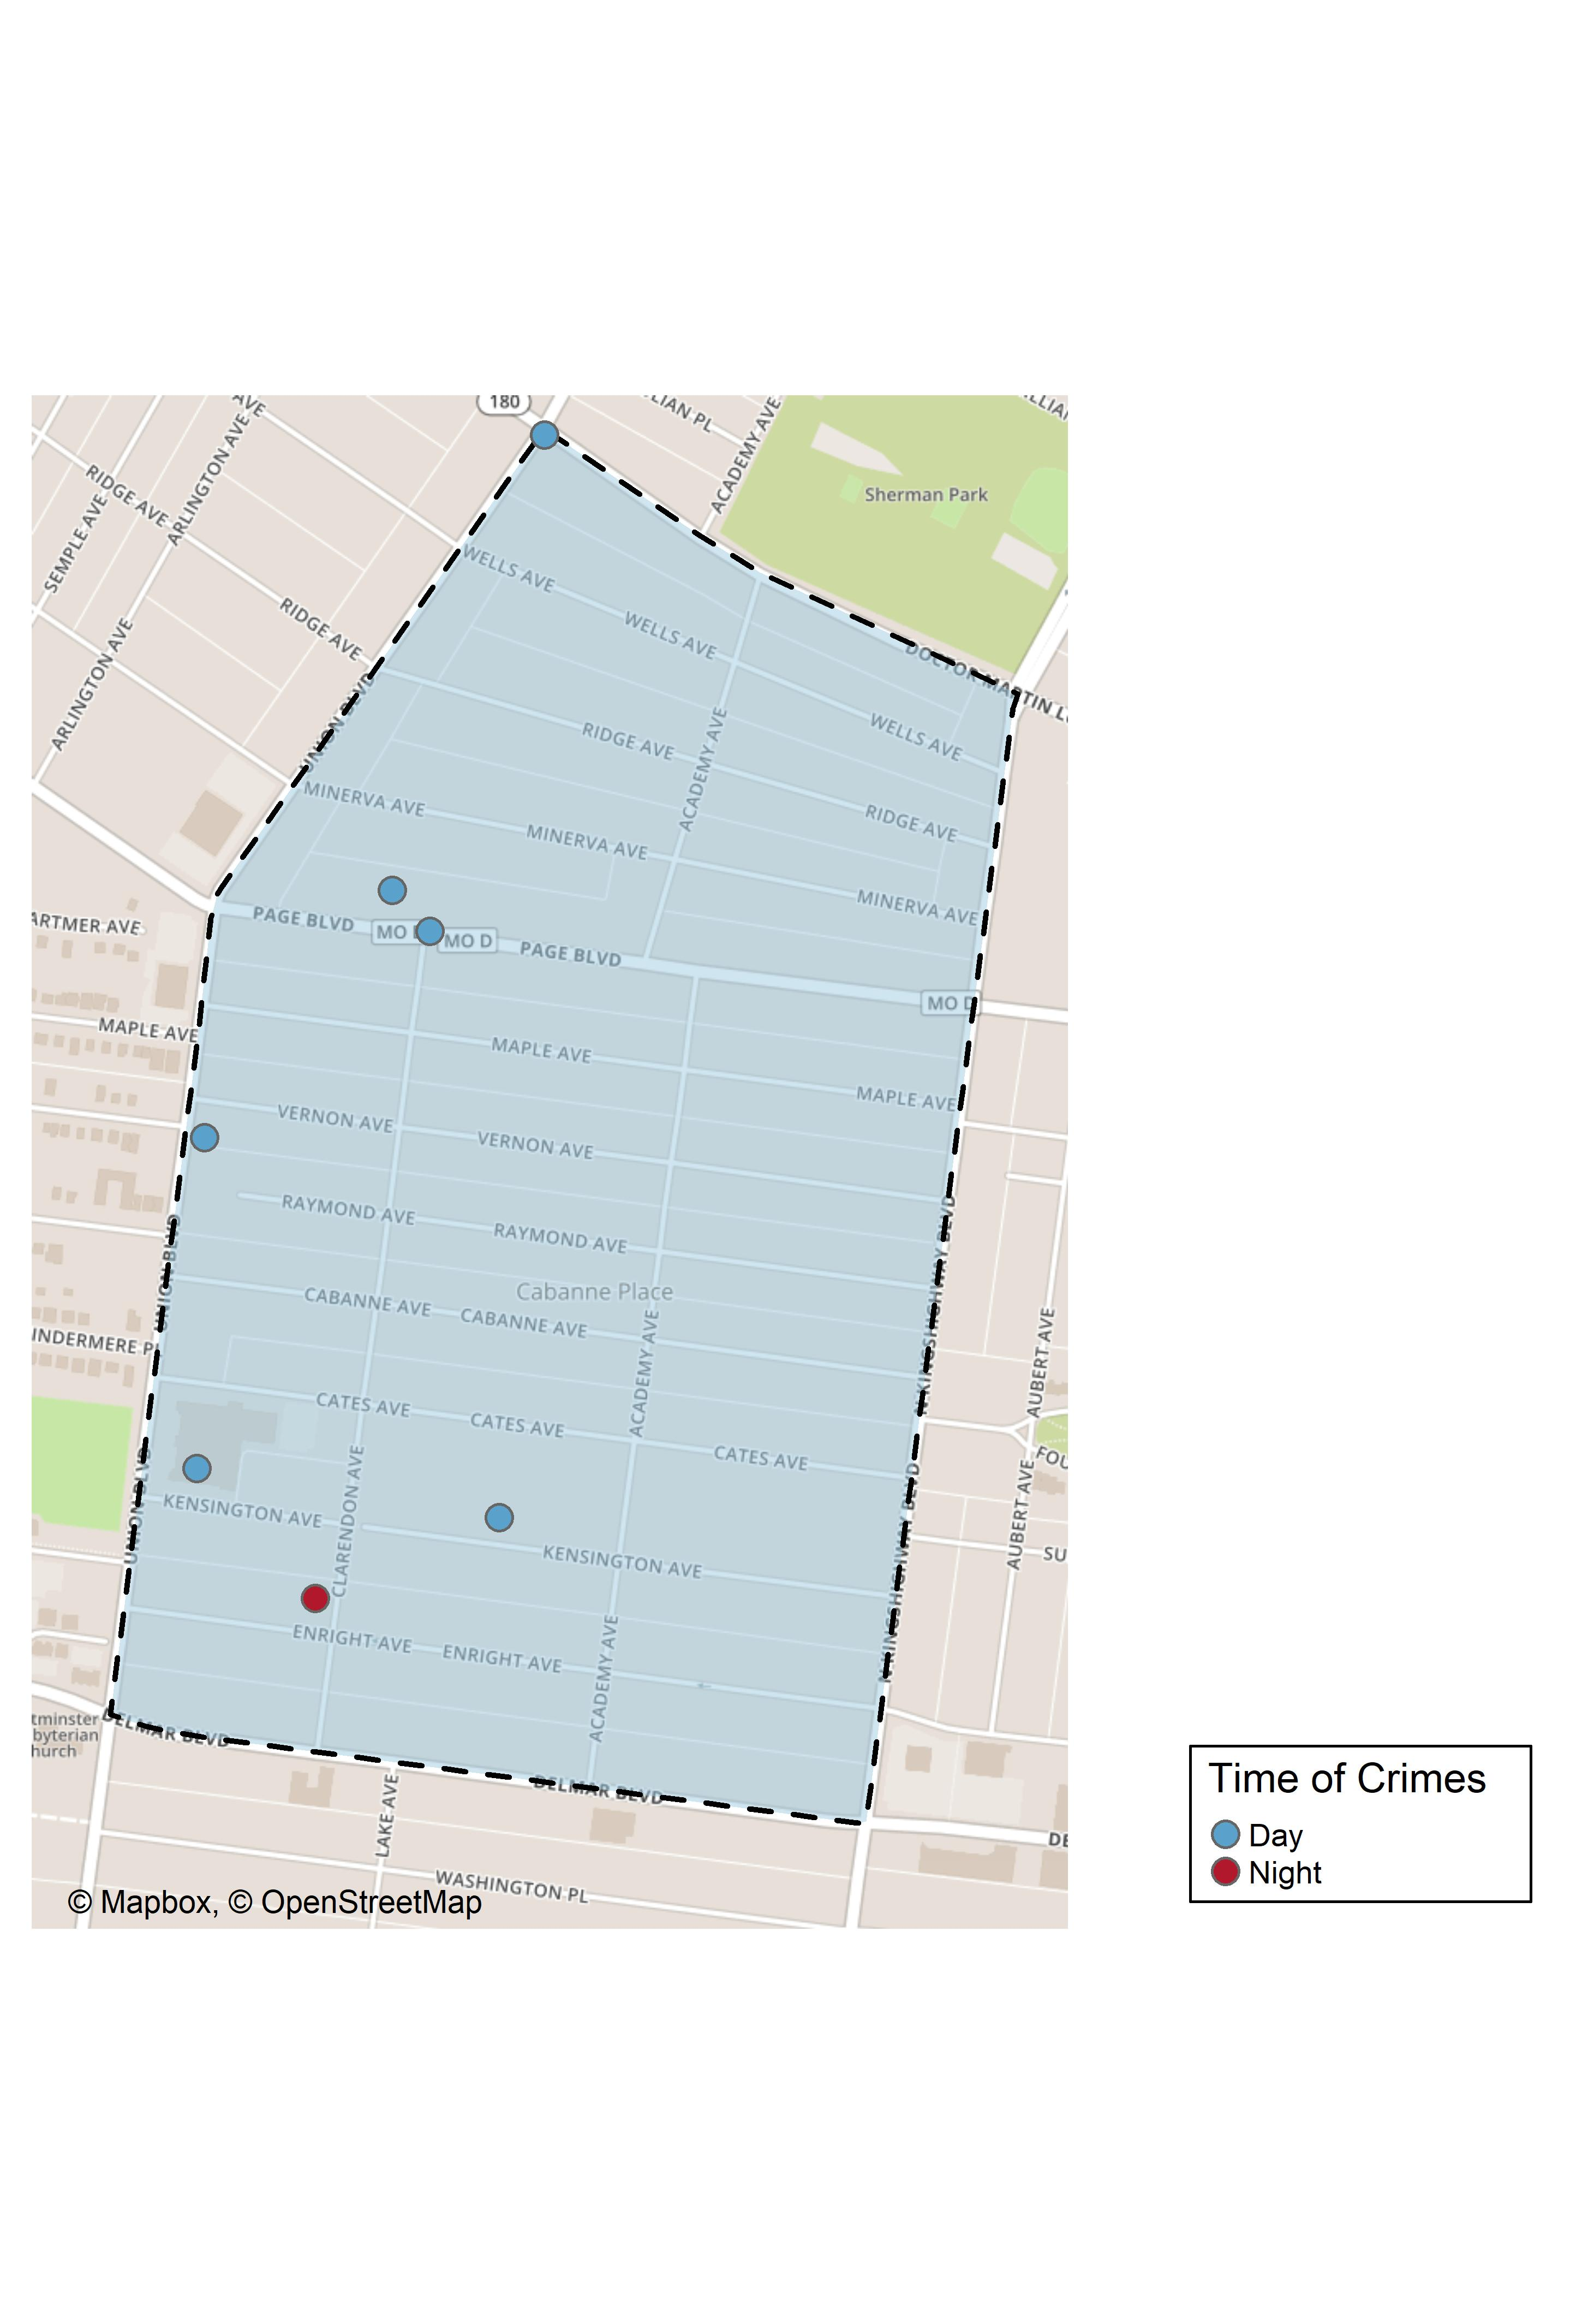
Academy: Time of Crimes Map

Slide 22
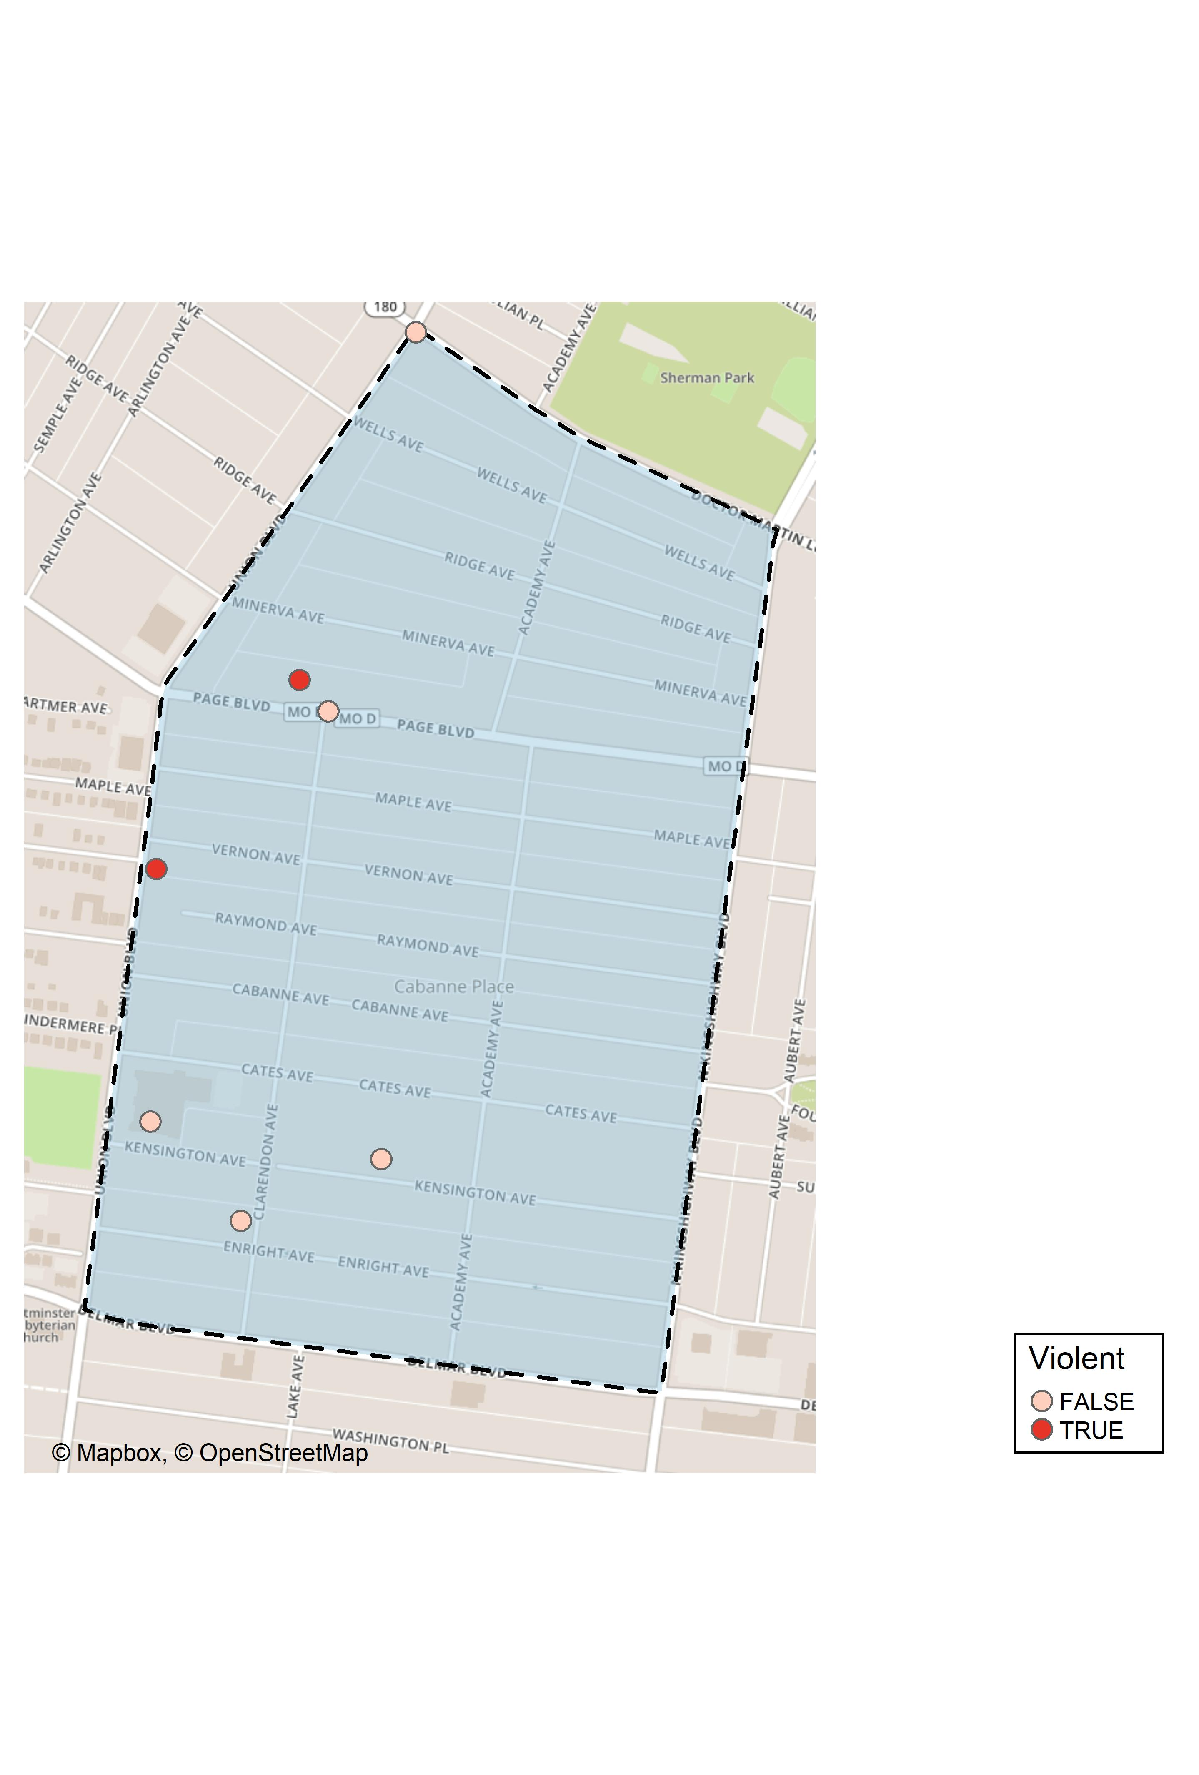
Academy: Violent Crime Map

Slide 23
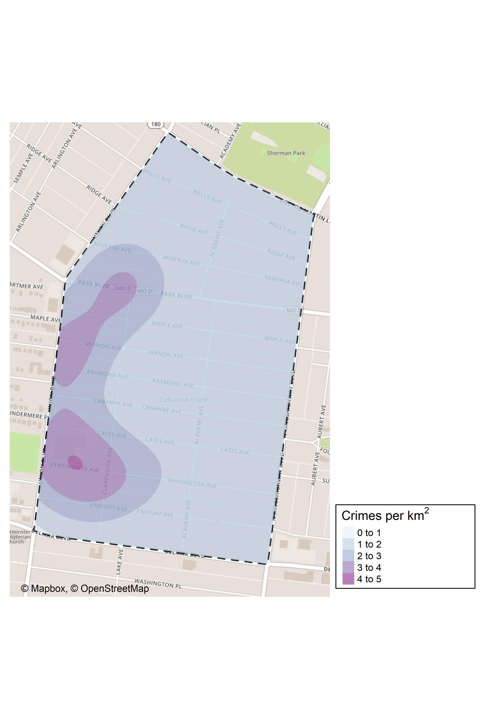
Academy: Crime Density Map

Slide 24
Academy: Larceny Breakdown
Day of the Week | Number of Crimes
Mon | 1
Thu | 1
Total | 2
Time of Day | Number of Crimes
Day | 2
Total | 2
Type of Larceny | Number of Crimes
From Building | 1
From Motor Vehicle | 1
Total | 2
Monetary | Number of Crimes
Under $500 | 2
Total | 2

Slide 25
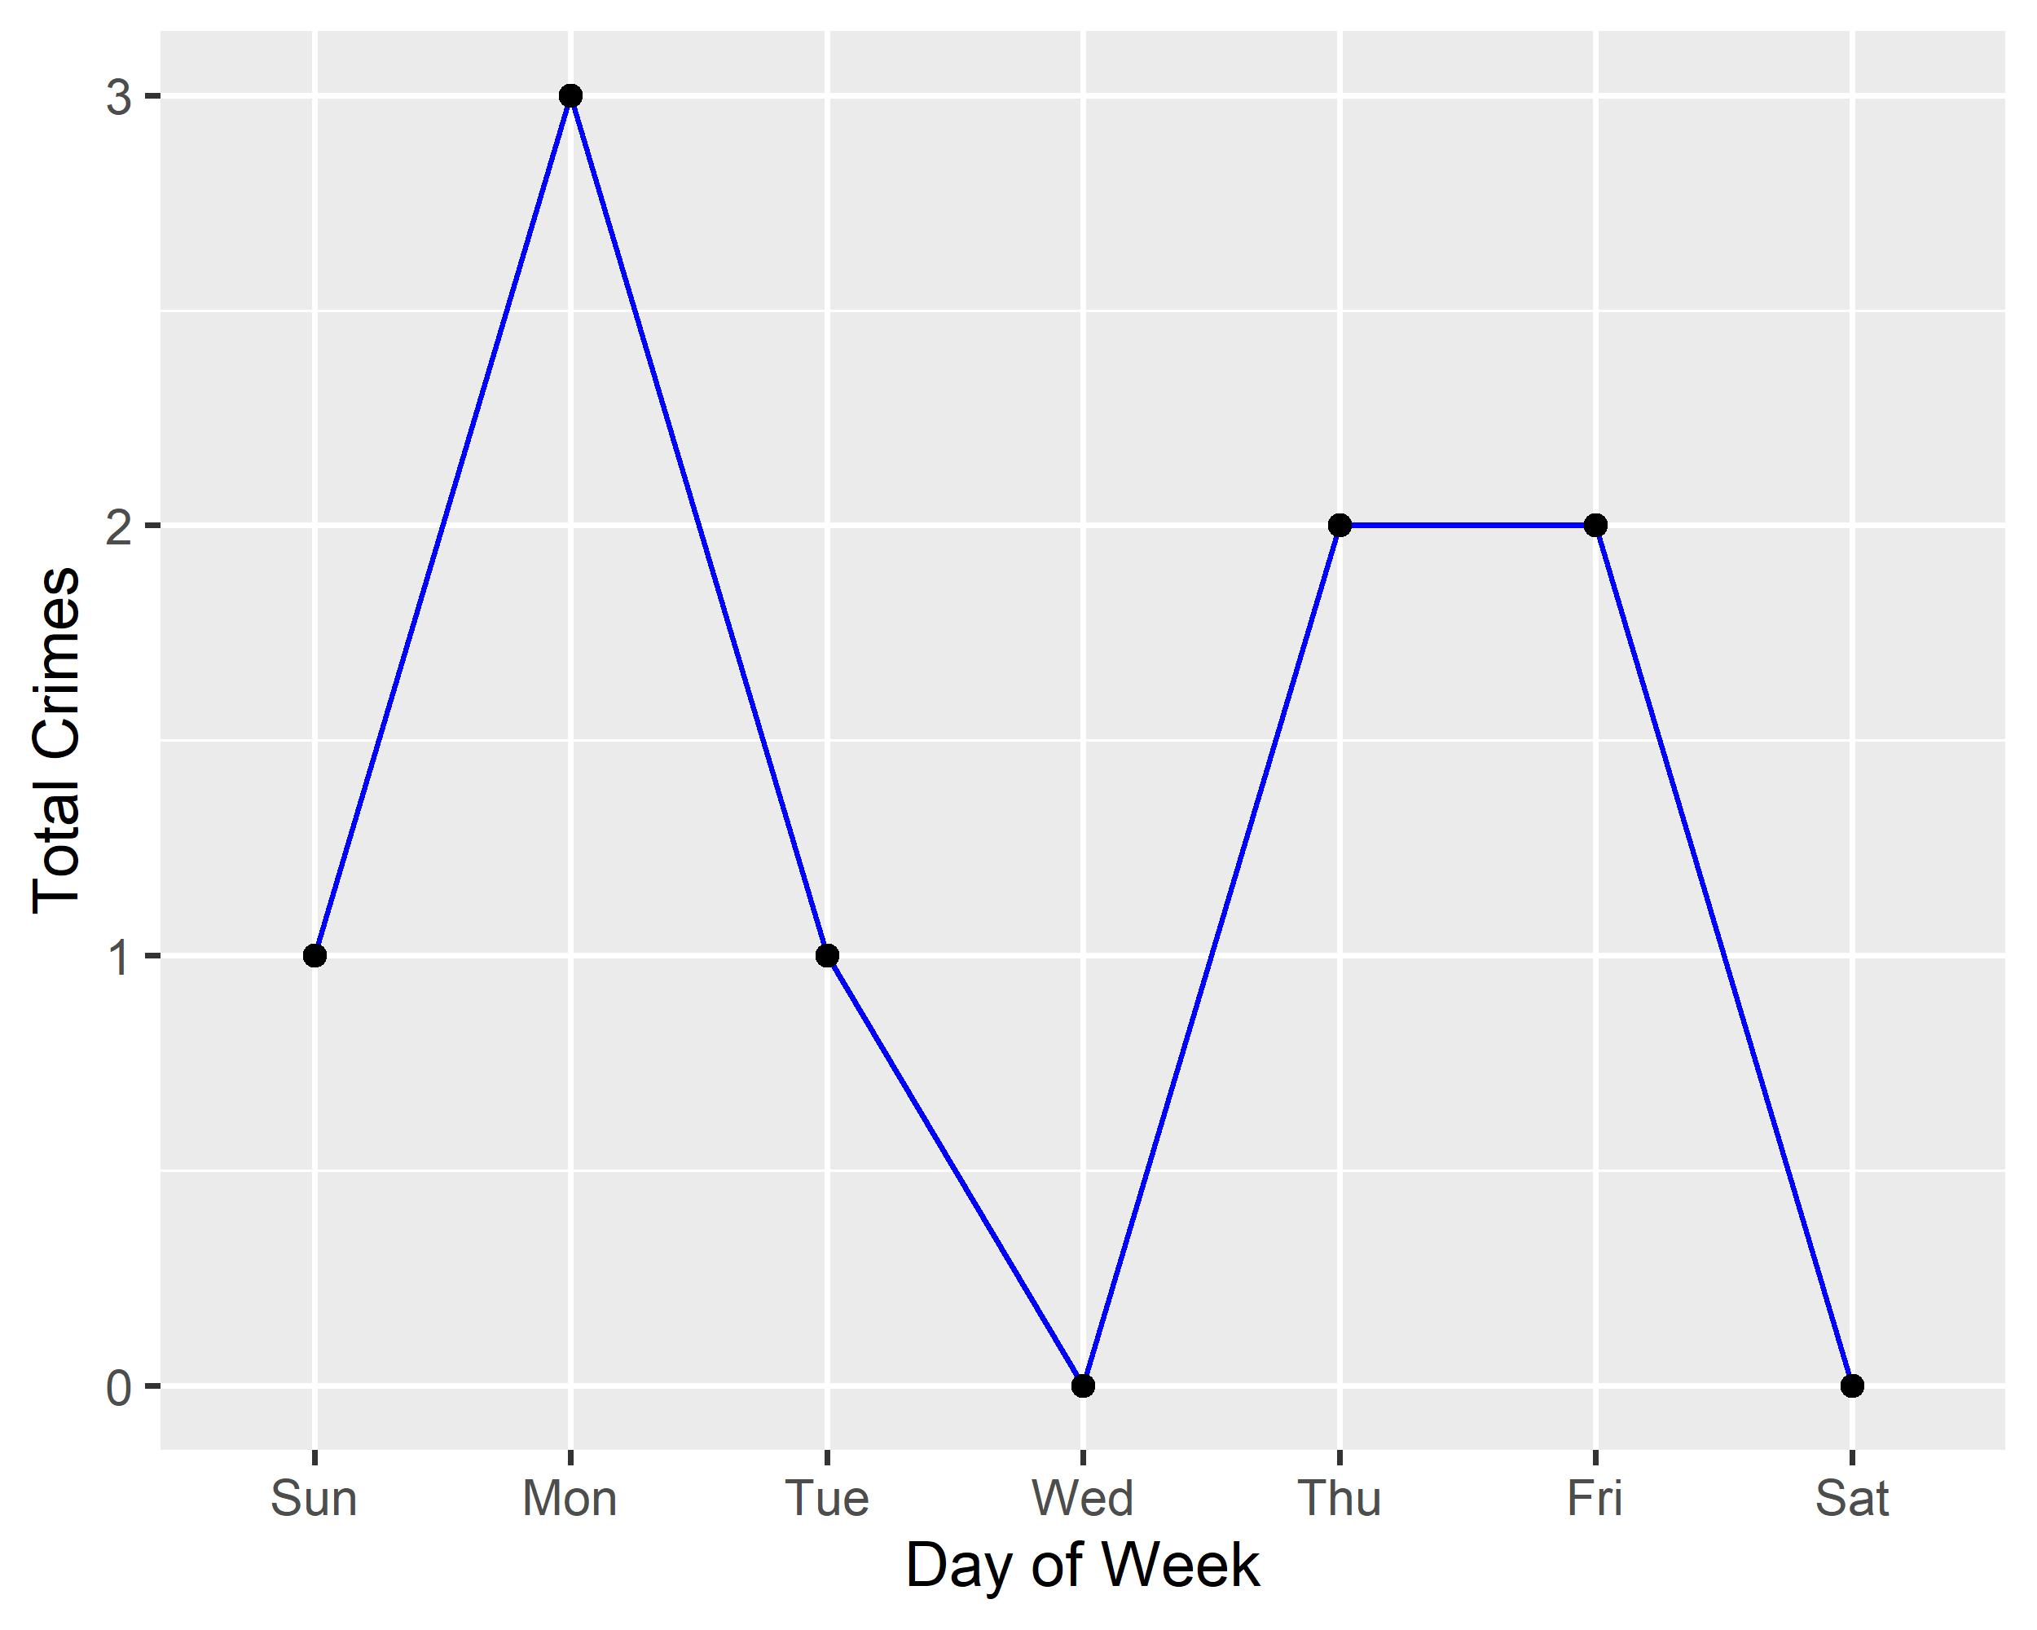
Academy: Total Crimes by Days of the Week

Slide 26
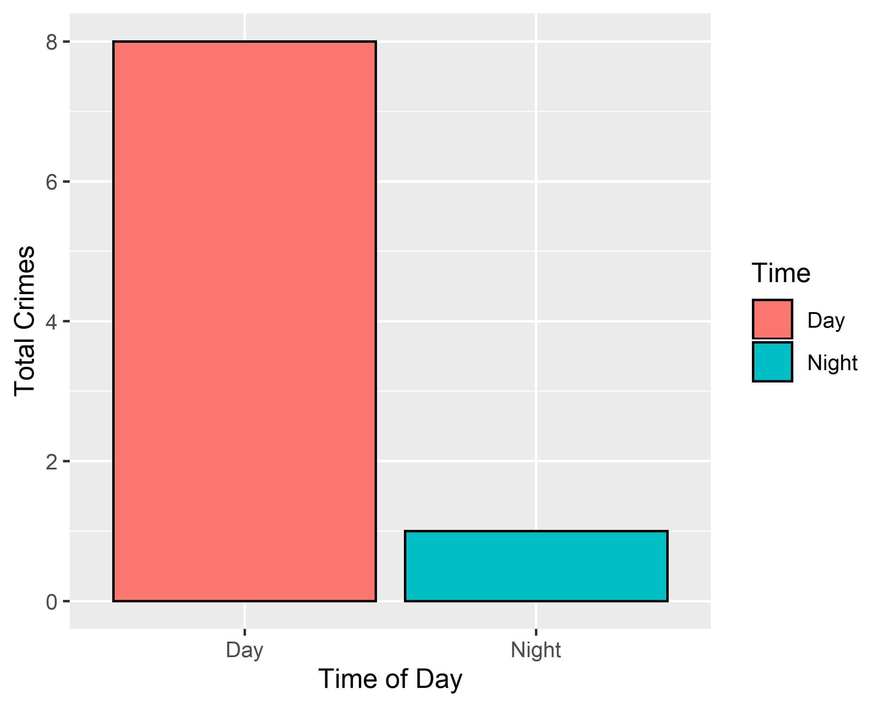
Academy: Crimes by Time of Day

Slide 27
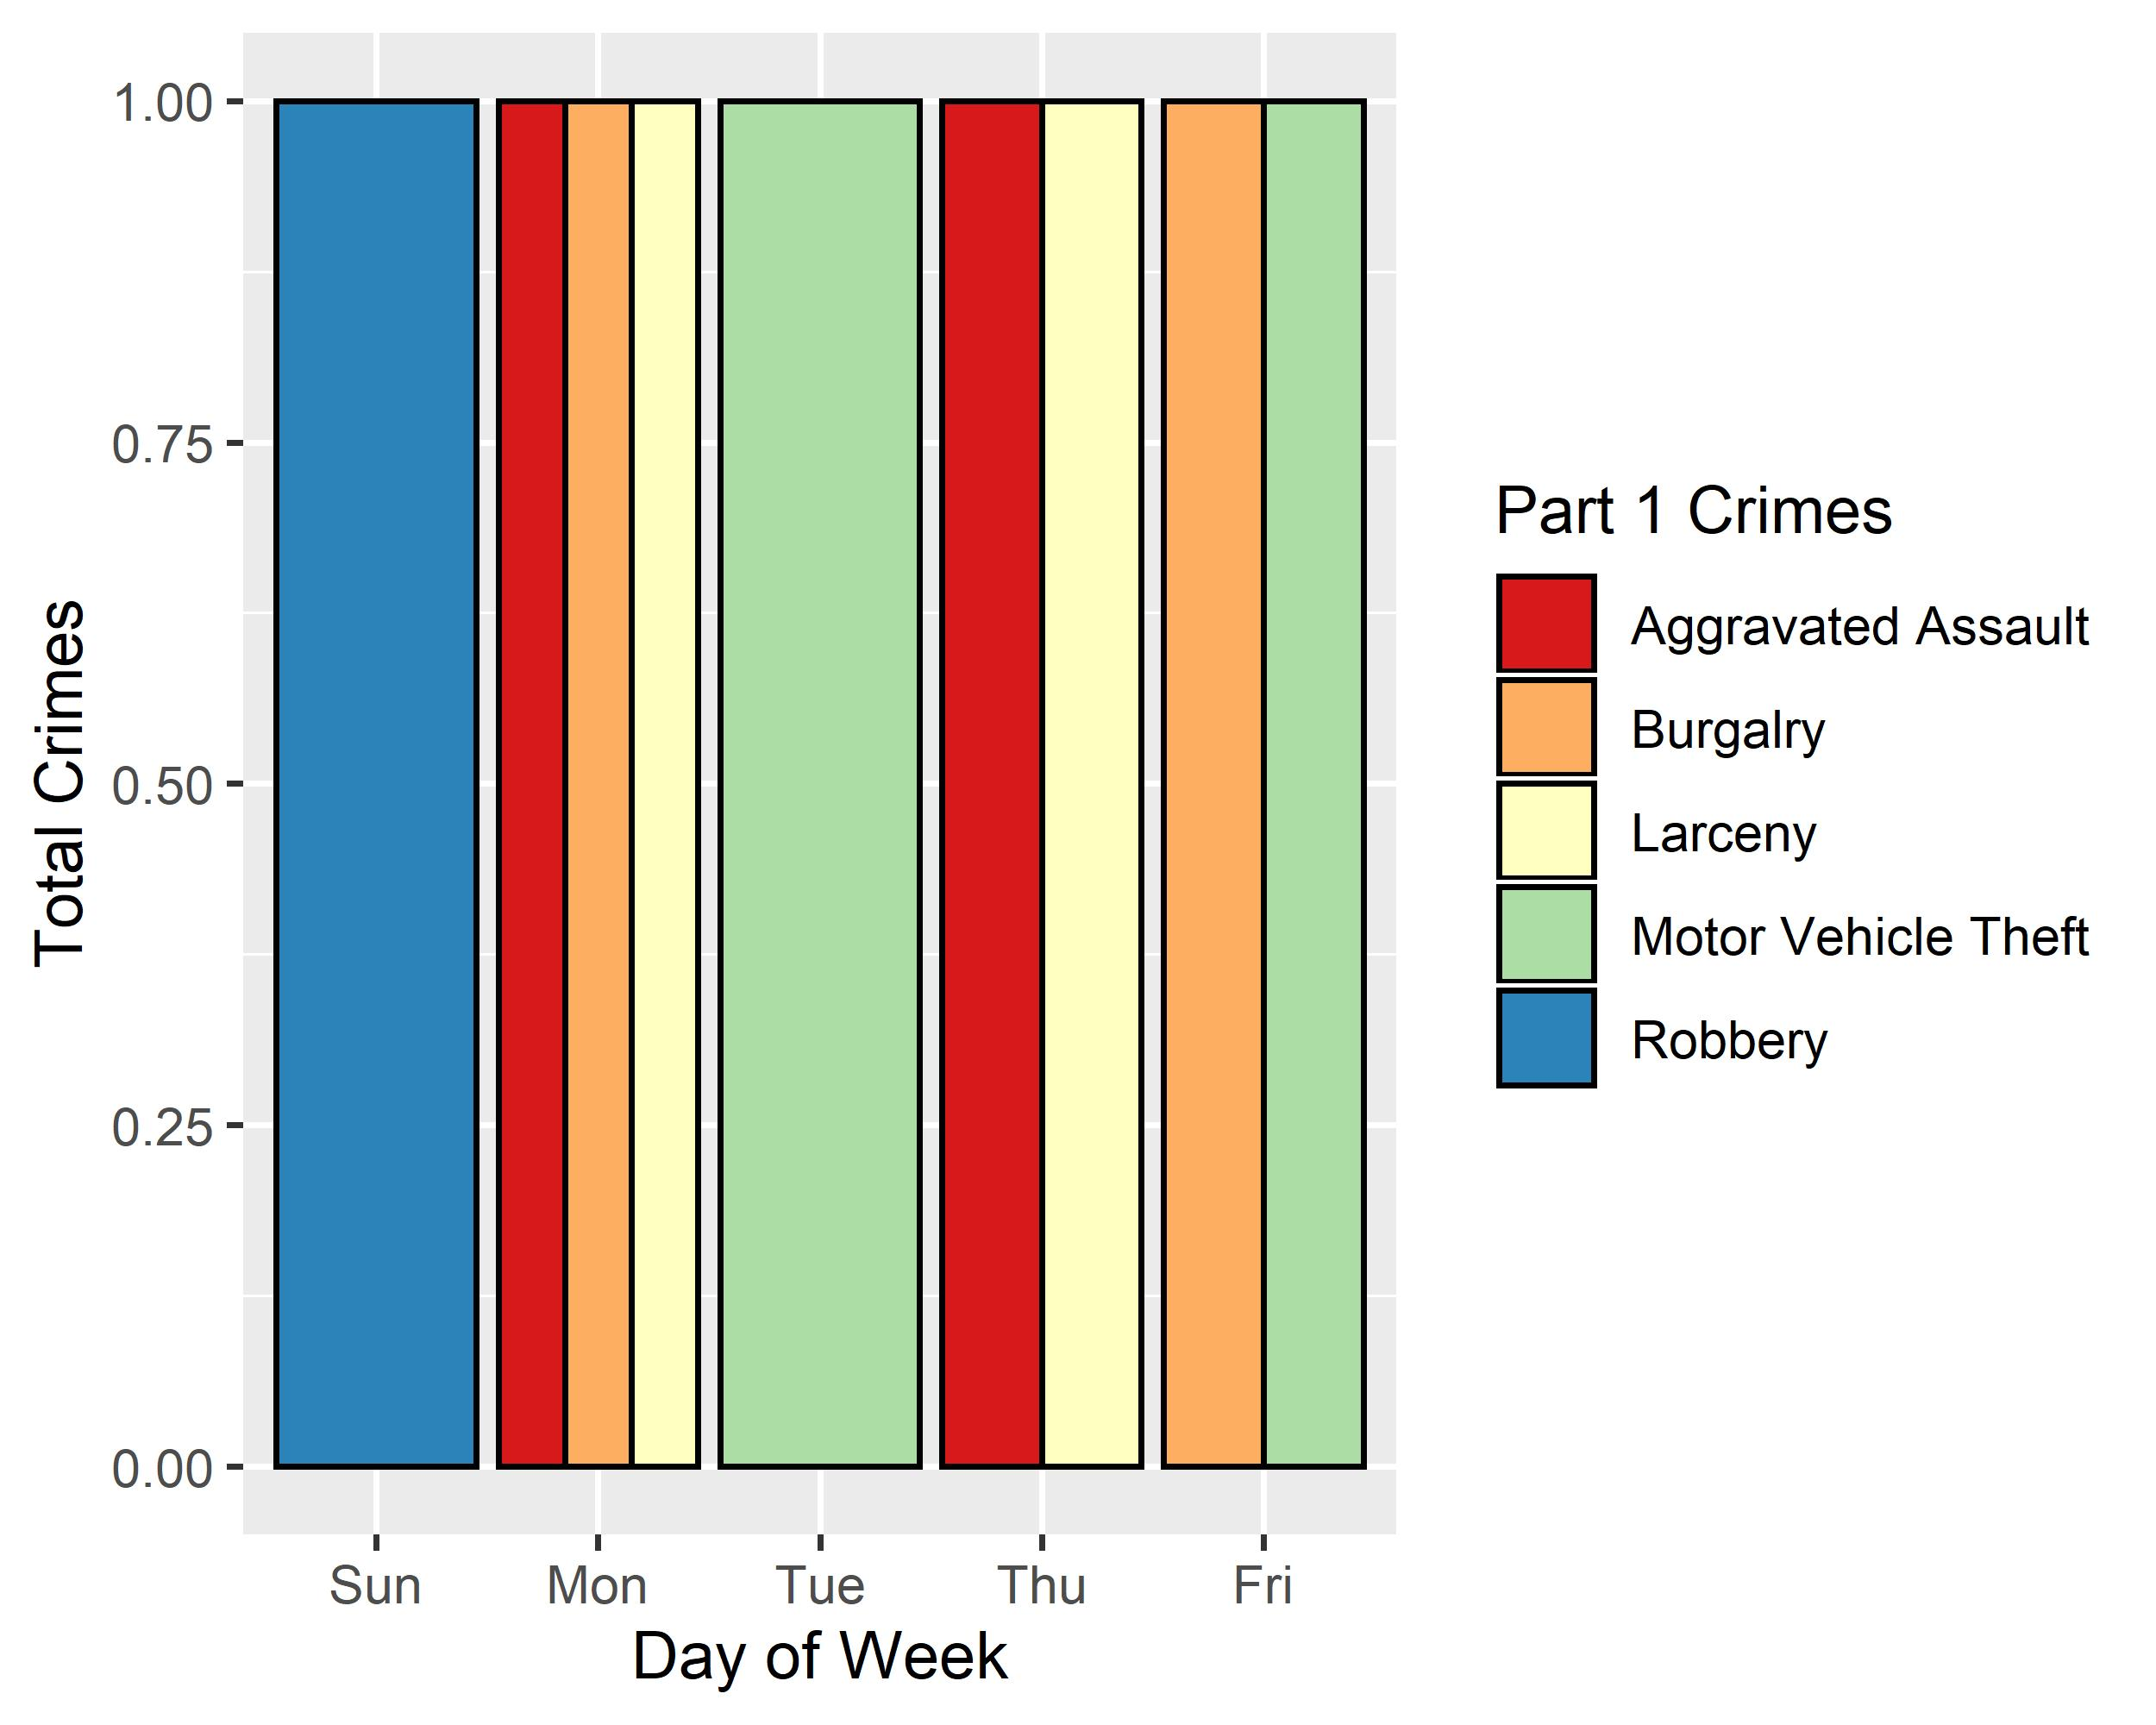
Academy: Crimes by Day & Category

Slide 28
Fountain Park: Neighborhood Detail
Appendix 2

Slide 29
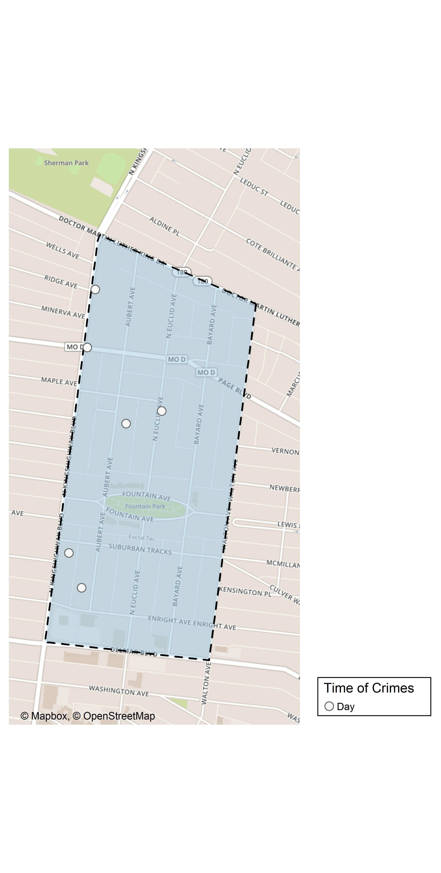
Fountain Park: Time of Crimes Map

Slide 30
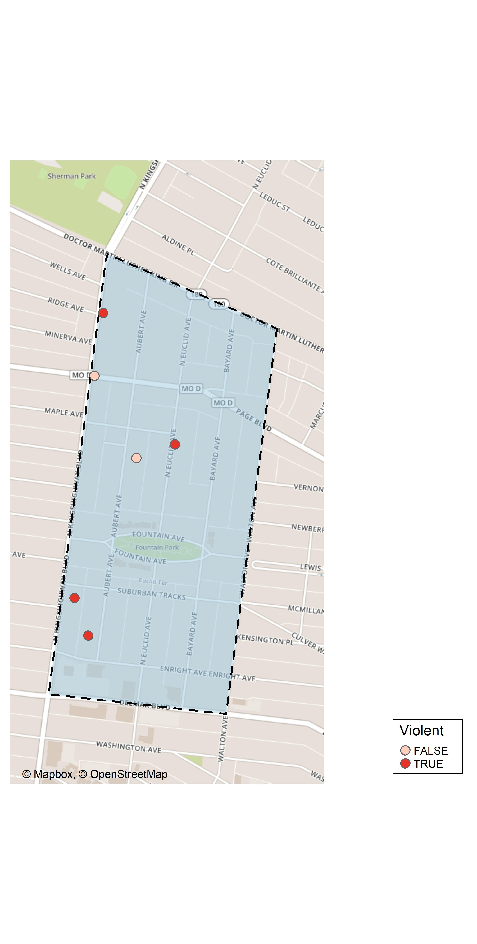
Fountain Park: Violent Crime Map

Slide 31
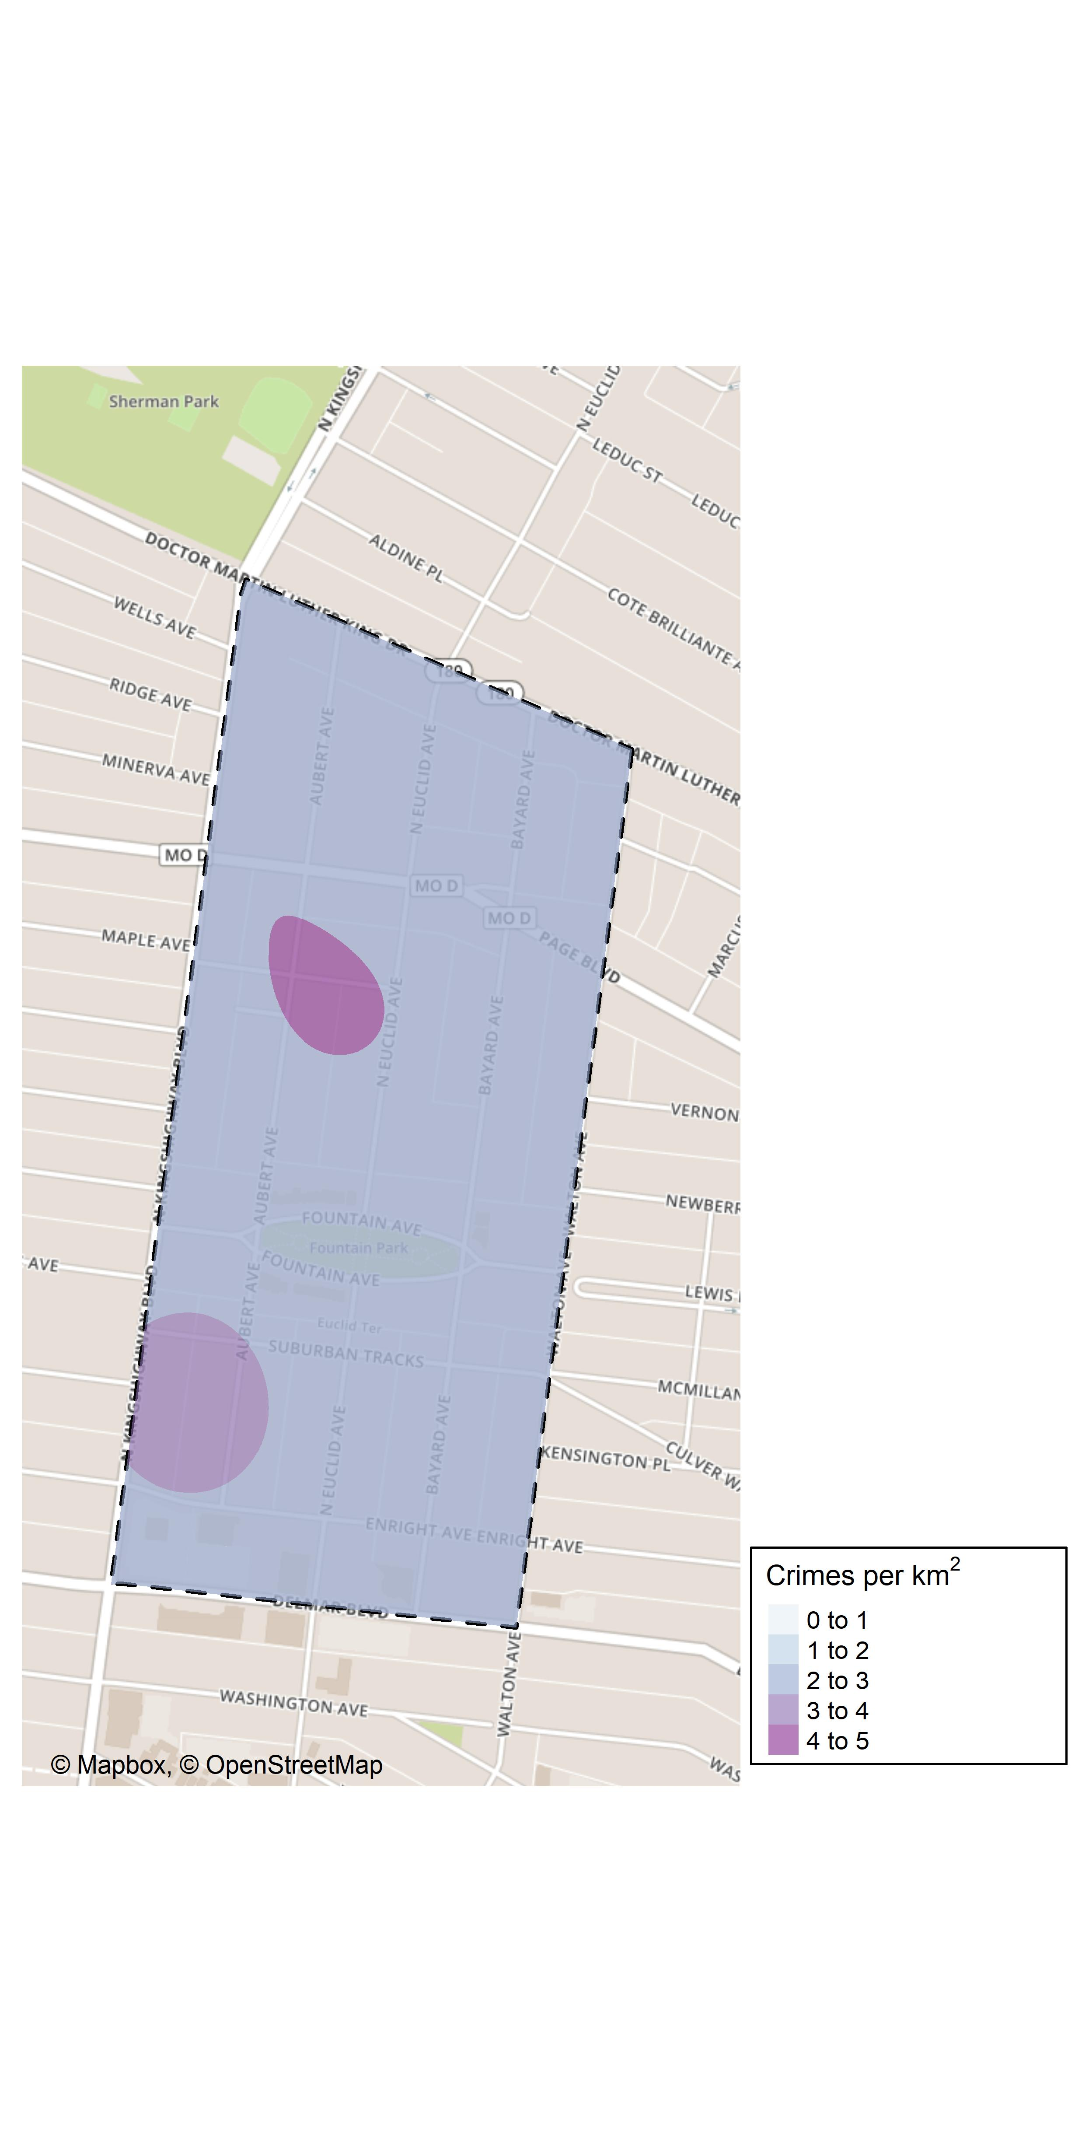
Fountain Park: Crime Density Map

Slide 32
Fountain Park: Larceny Breakdown
Day of the Week | Number of Crimes
Wed | 1
Thu | 1
Total | 2
Time of Day | Number of Crimes
Day | 2
Total | 2
Type of Larceny | Number of Crimes
From Building | 1
From Motor Vehicle | 1
Total | 2
Monetary | Number of Crimes
$500 - $24,999 | 1
Under $500 | 1
Total | 2

Slide 33
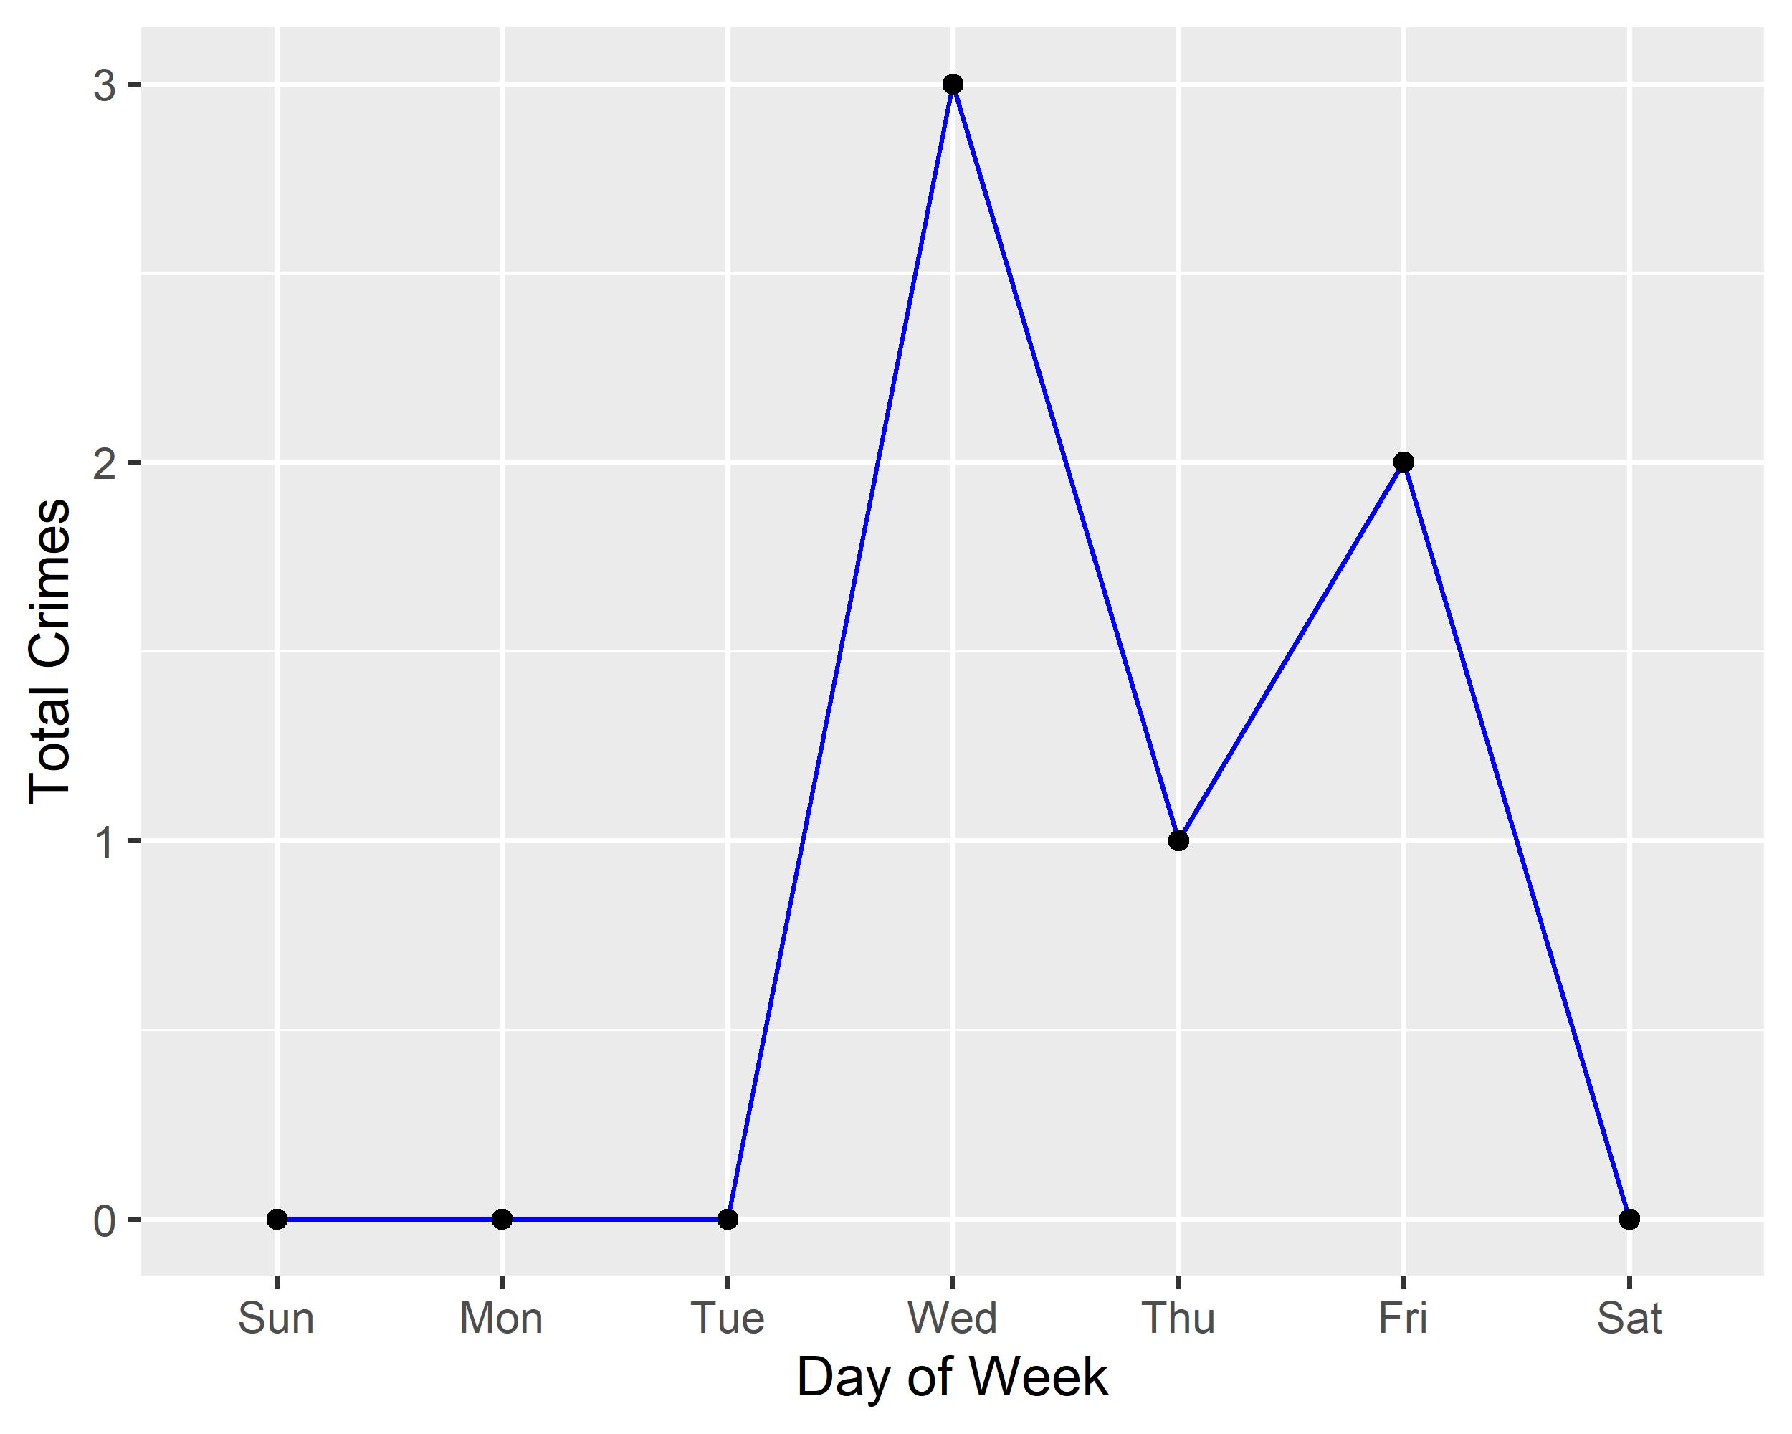
Fountain Park: Total Crimes by Days of the Week

Slide 34
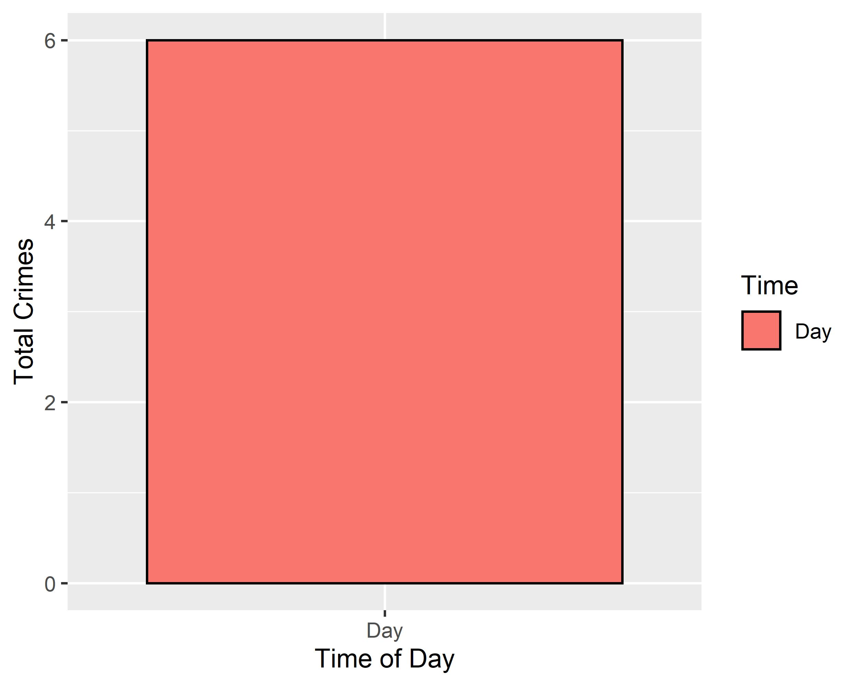
Fountain Park: Crimes by Time of Day

Slide 35
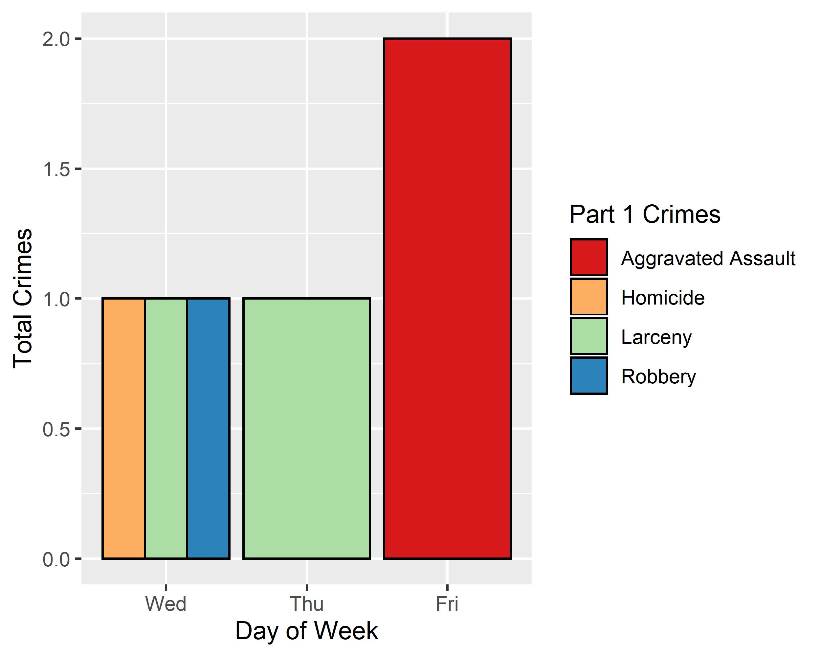
Fountain Park: Crimes by Day & Category

Slide 36
Lewis Place: Neighborhood Detail
Appendix 3

Slide 37
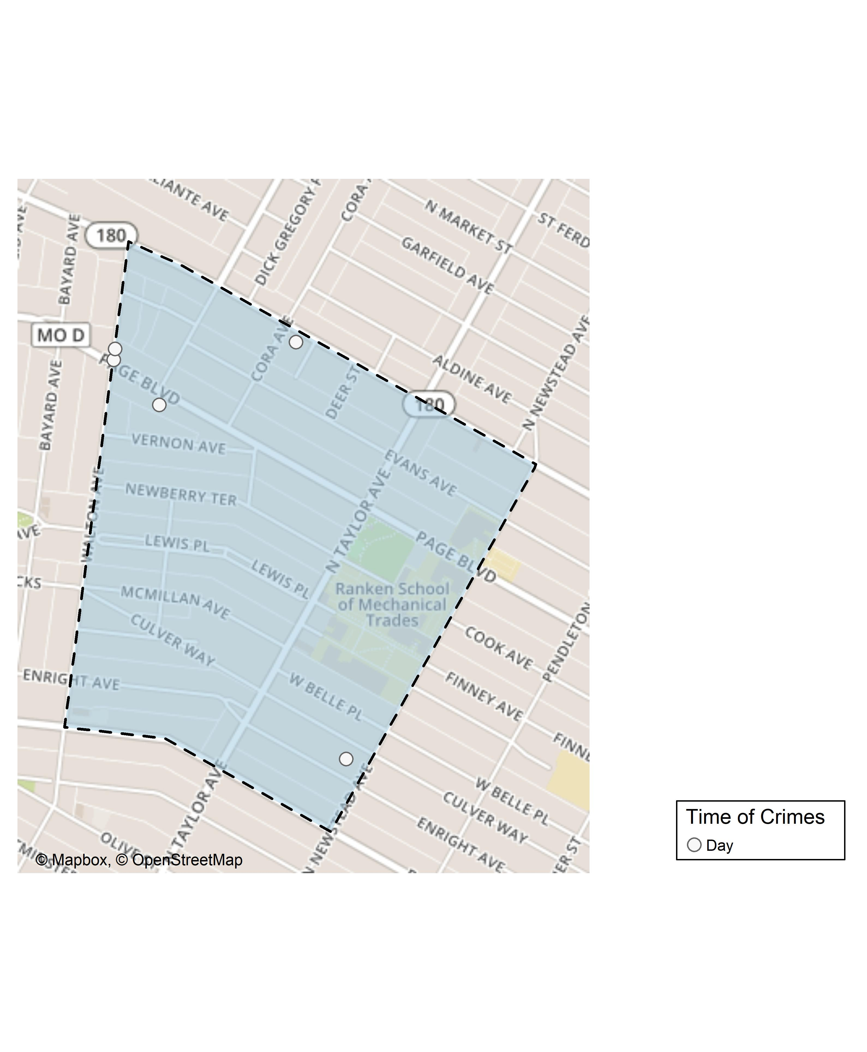
Lewis Place: Time of Crimes Map

Slide 38
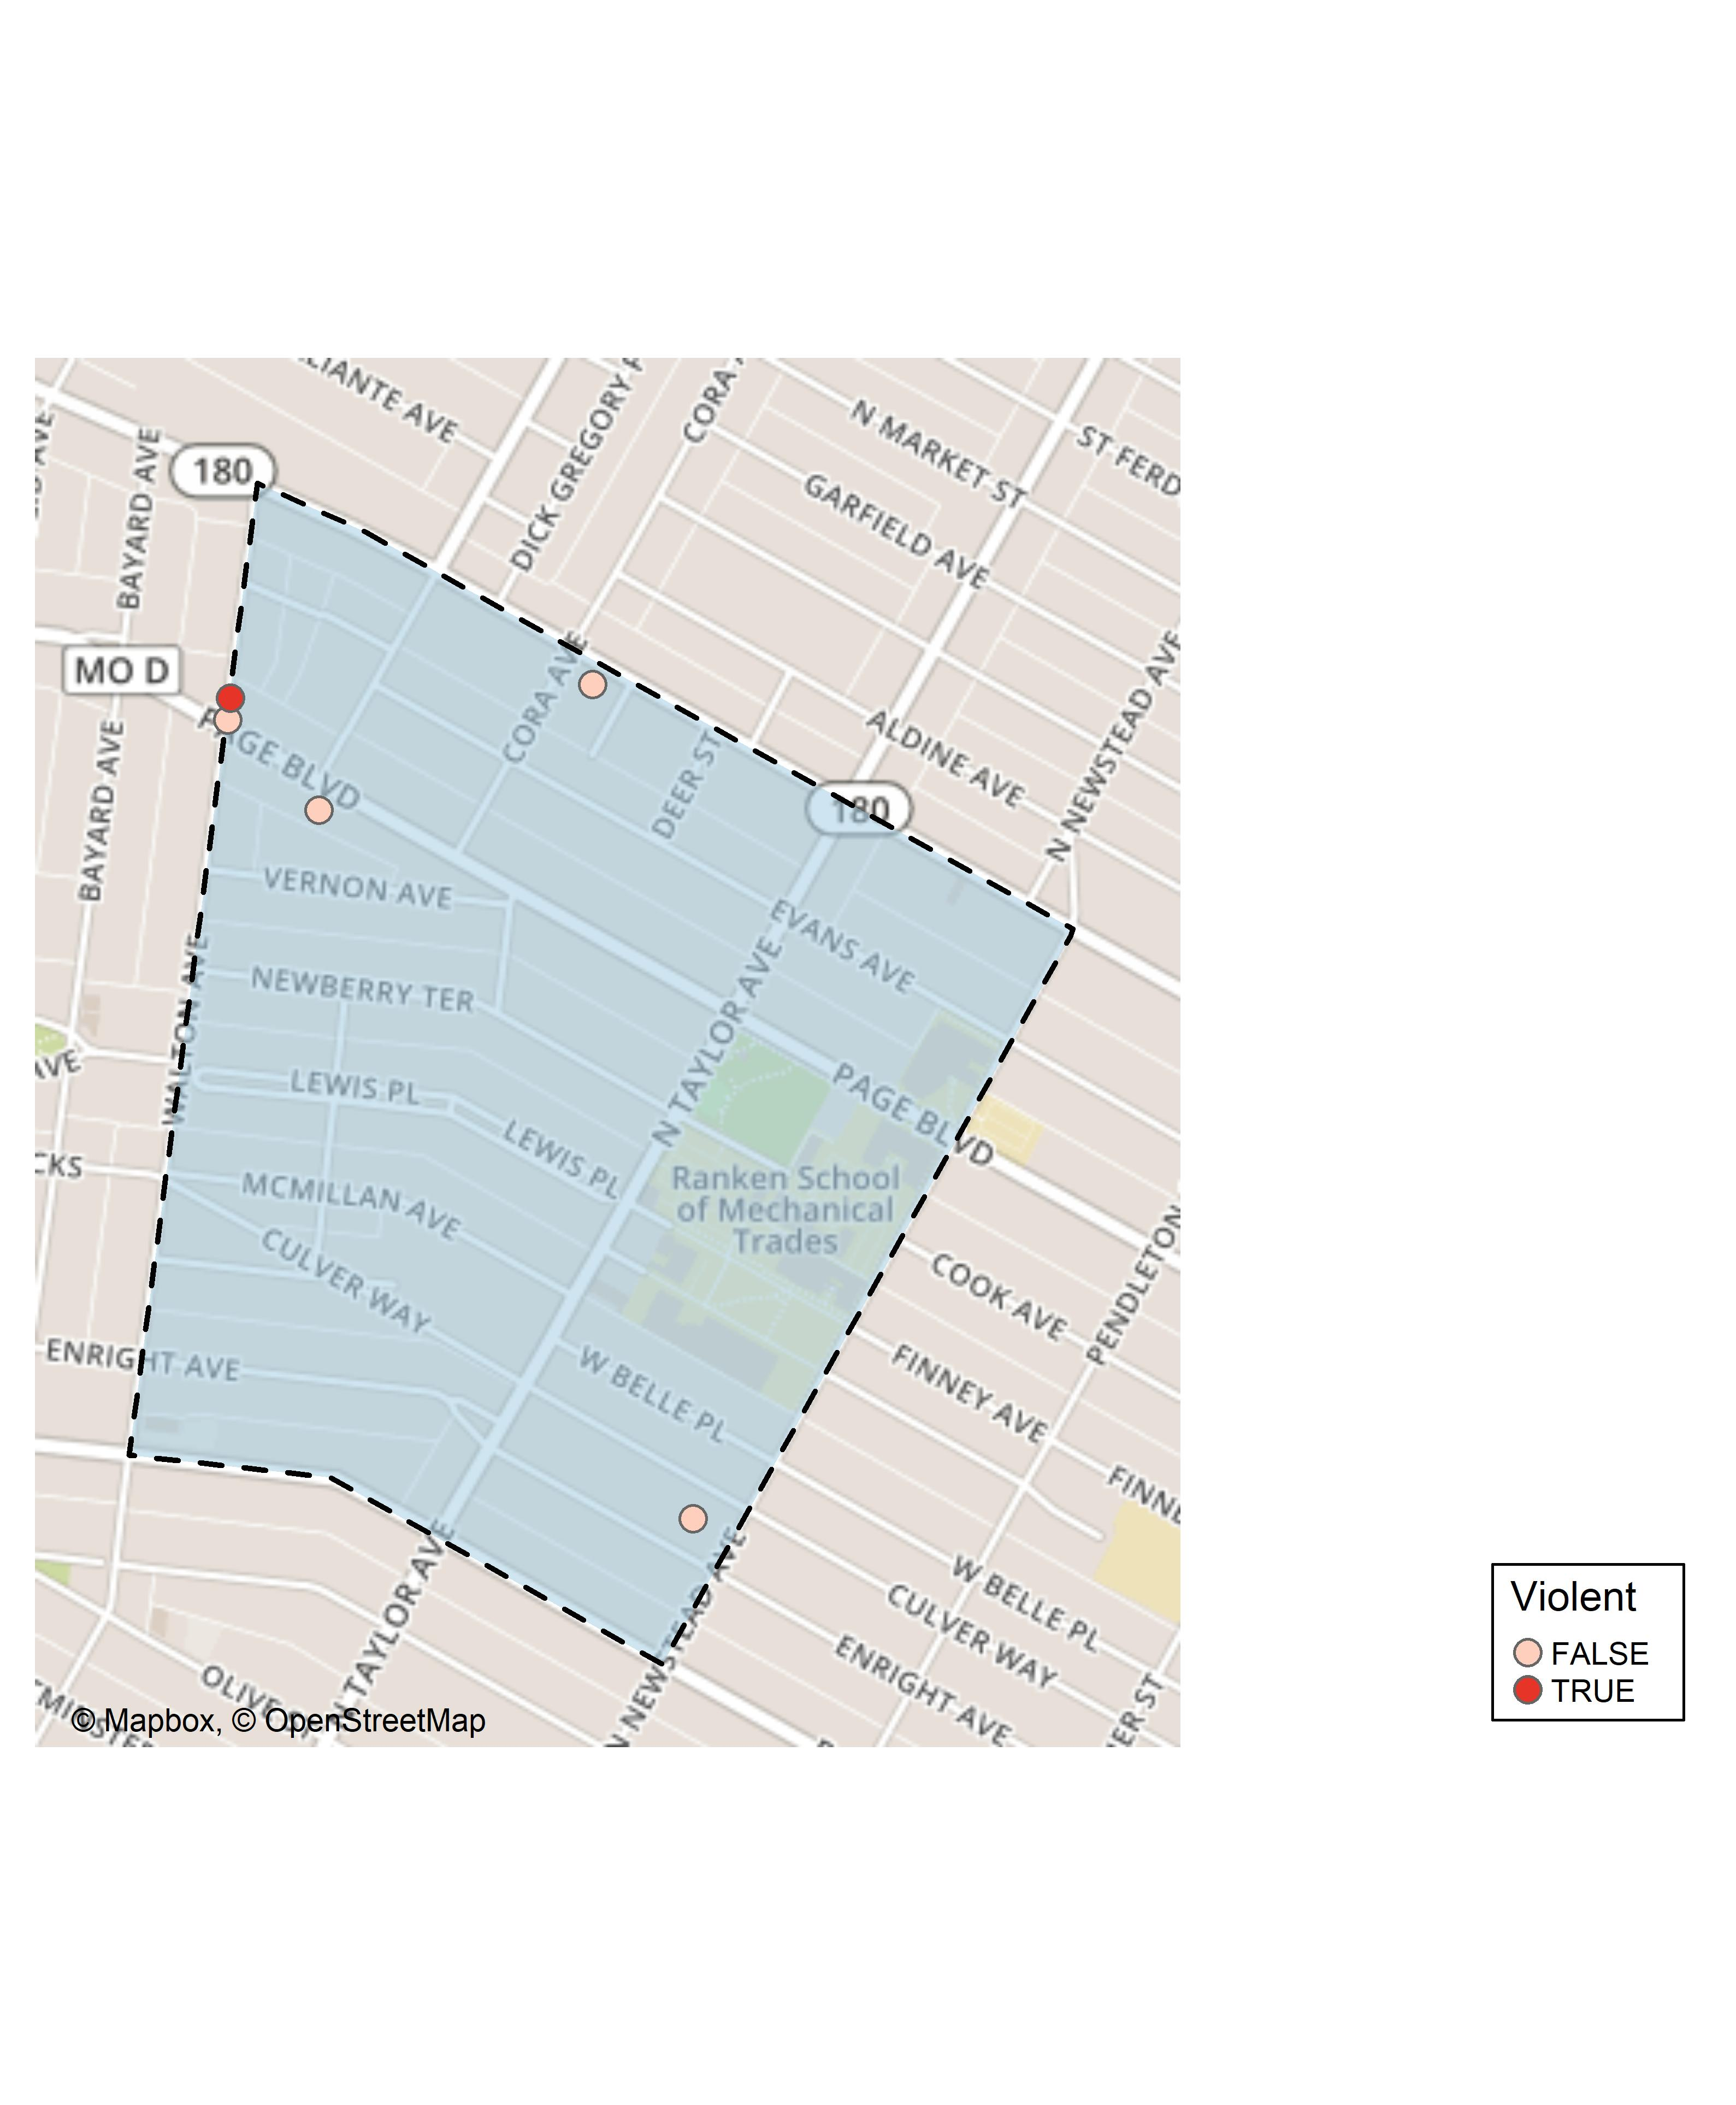
Lewis Place: Violent Crime Map

Slide 39
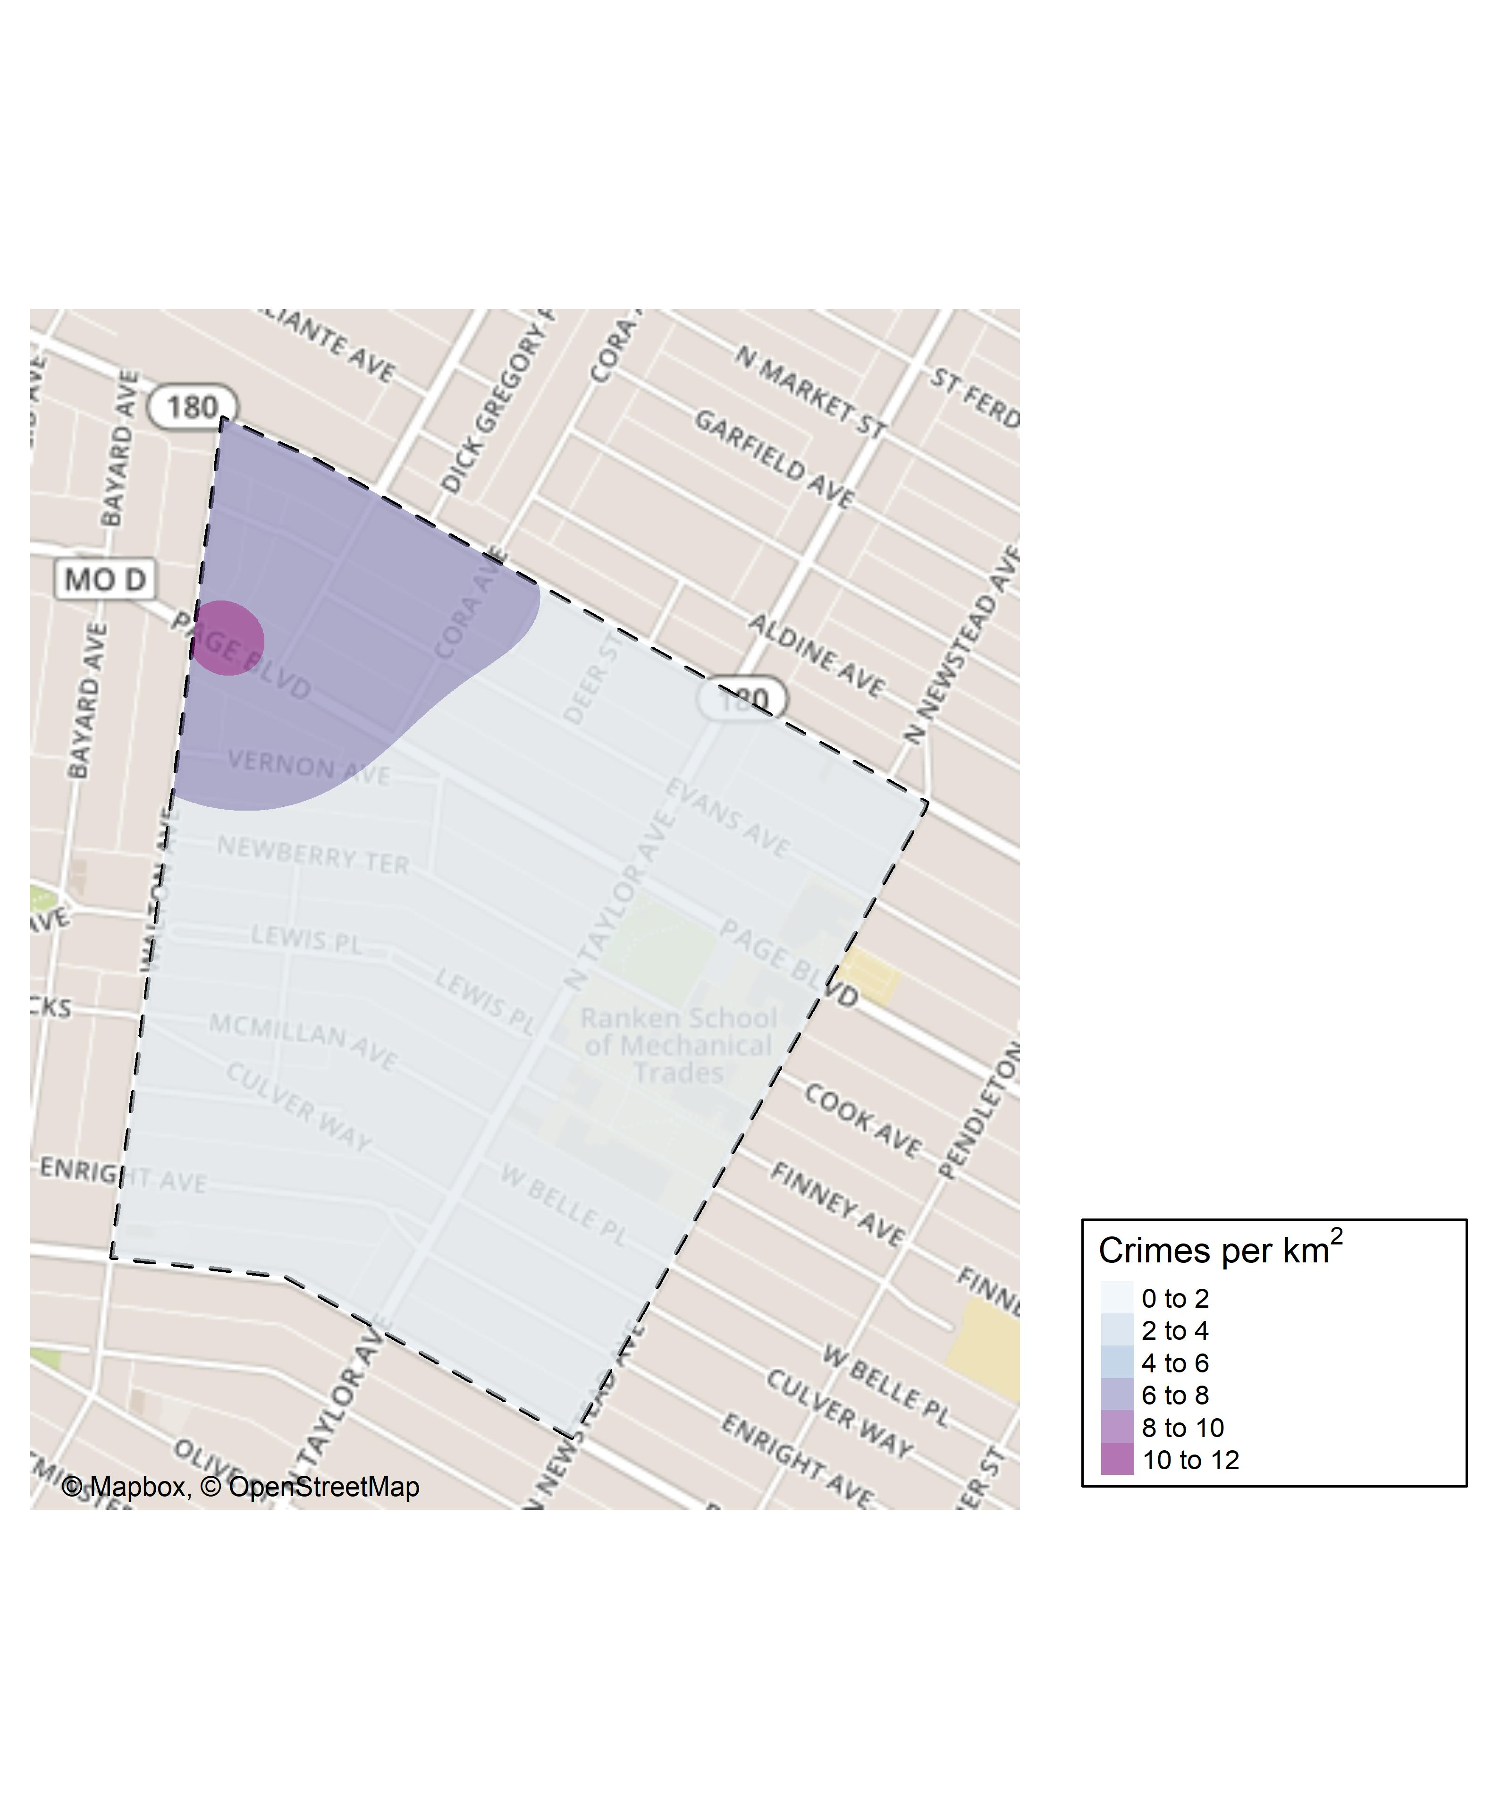
Lewis Place: Crime Density Map

Slide 40
Lewis Place: Larceny Breakdown
Day of the Week | Number of Crimes
Mon | 1
Fri | 1
Total | 2
Time of Day | Number of Crimes
Day | 2
Total | 2
Type of Larceny | Number of Crimes
From Motor Vehicle | 1
Motor Vehicle Parts | 1
Total | 2
Monetary | Number of Crimes
$500 - $24,999 | 1
Under $500 | 1
Total | 2

Slide 41
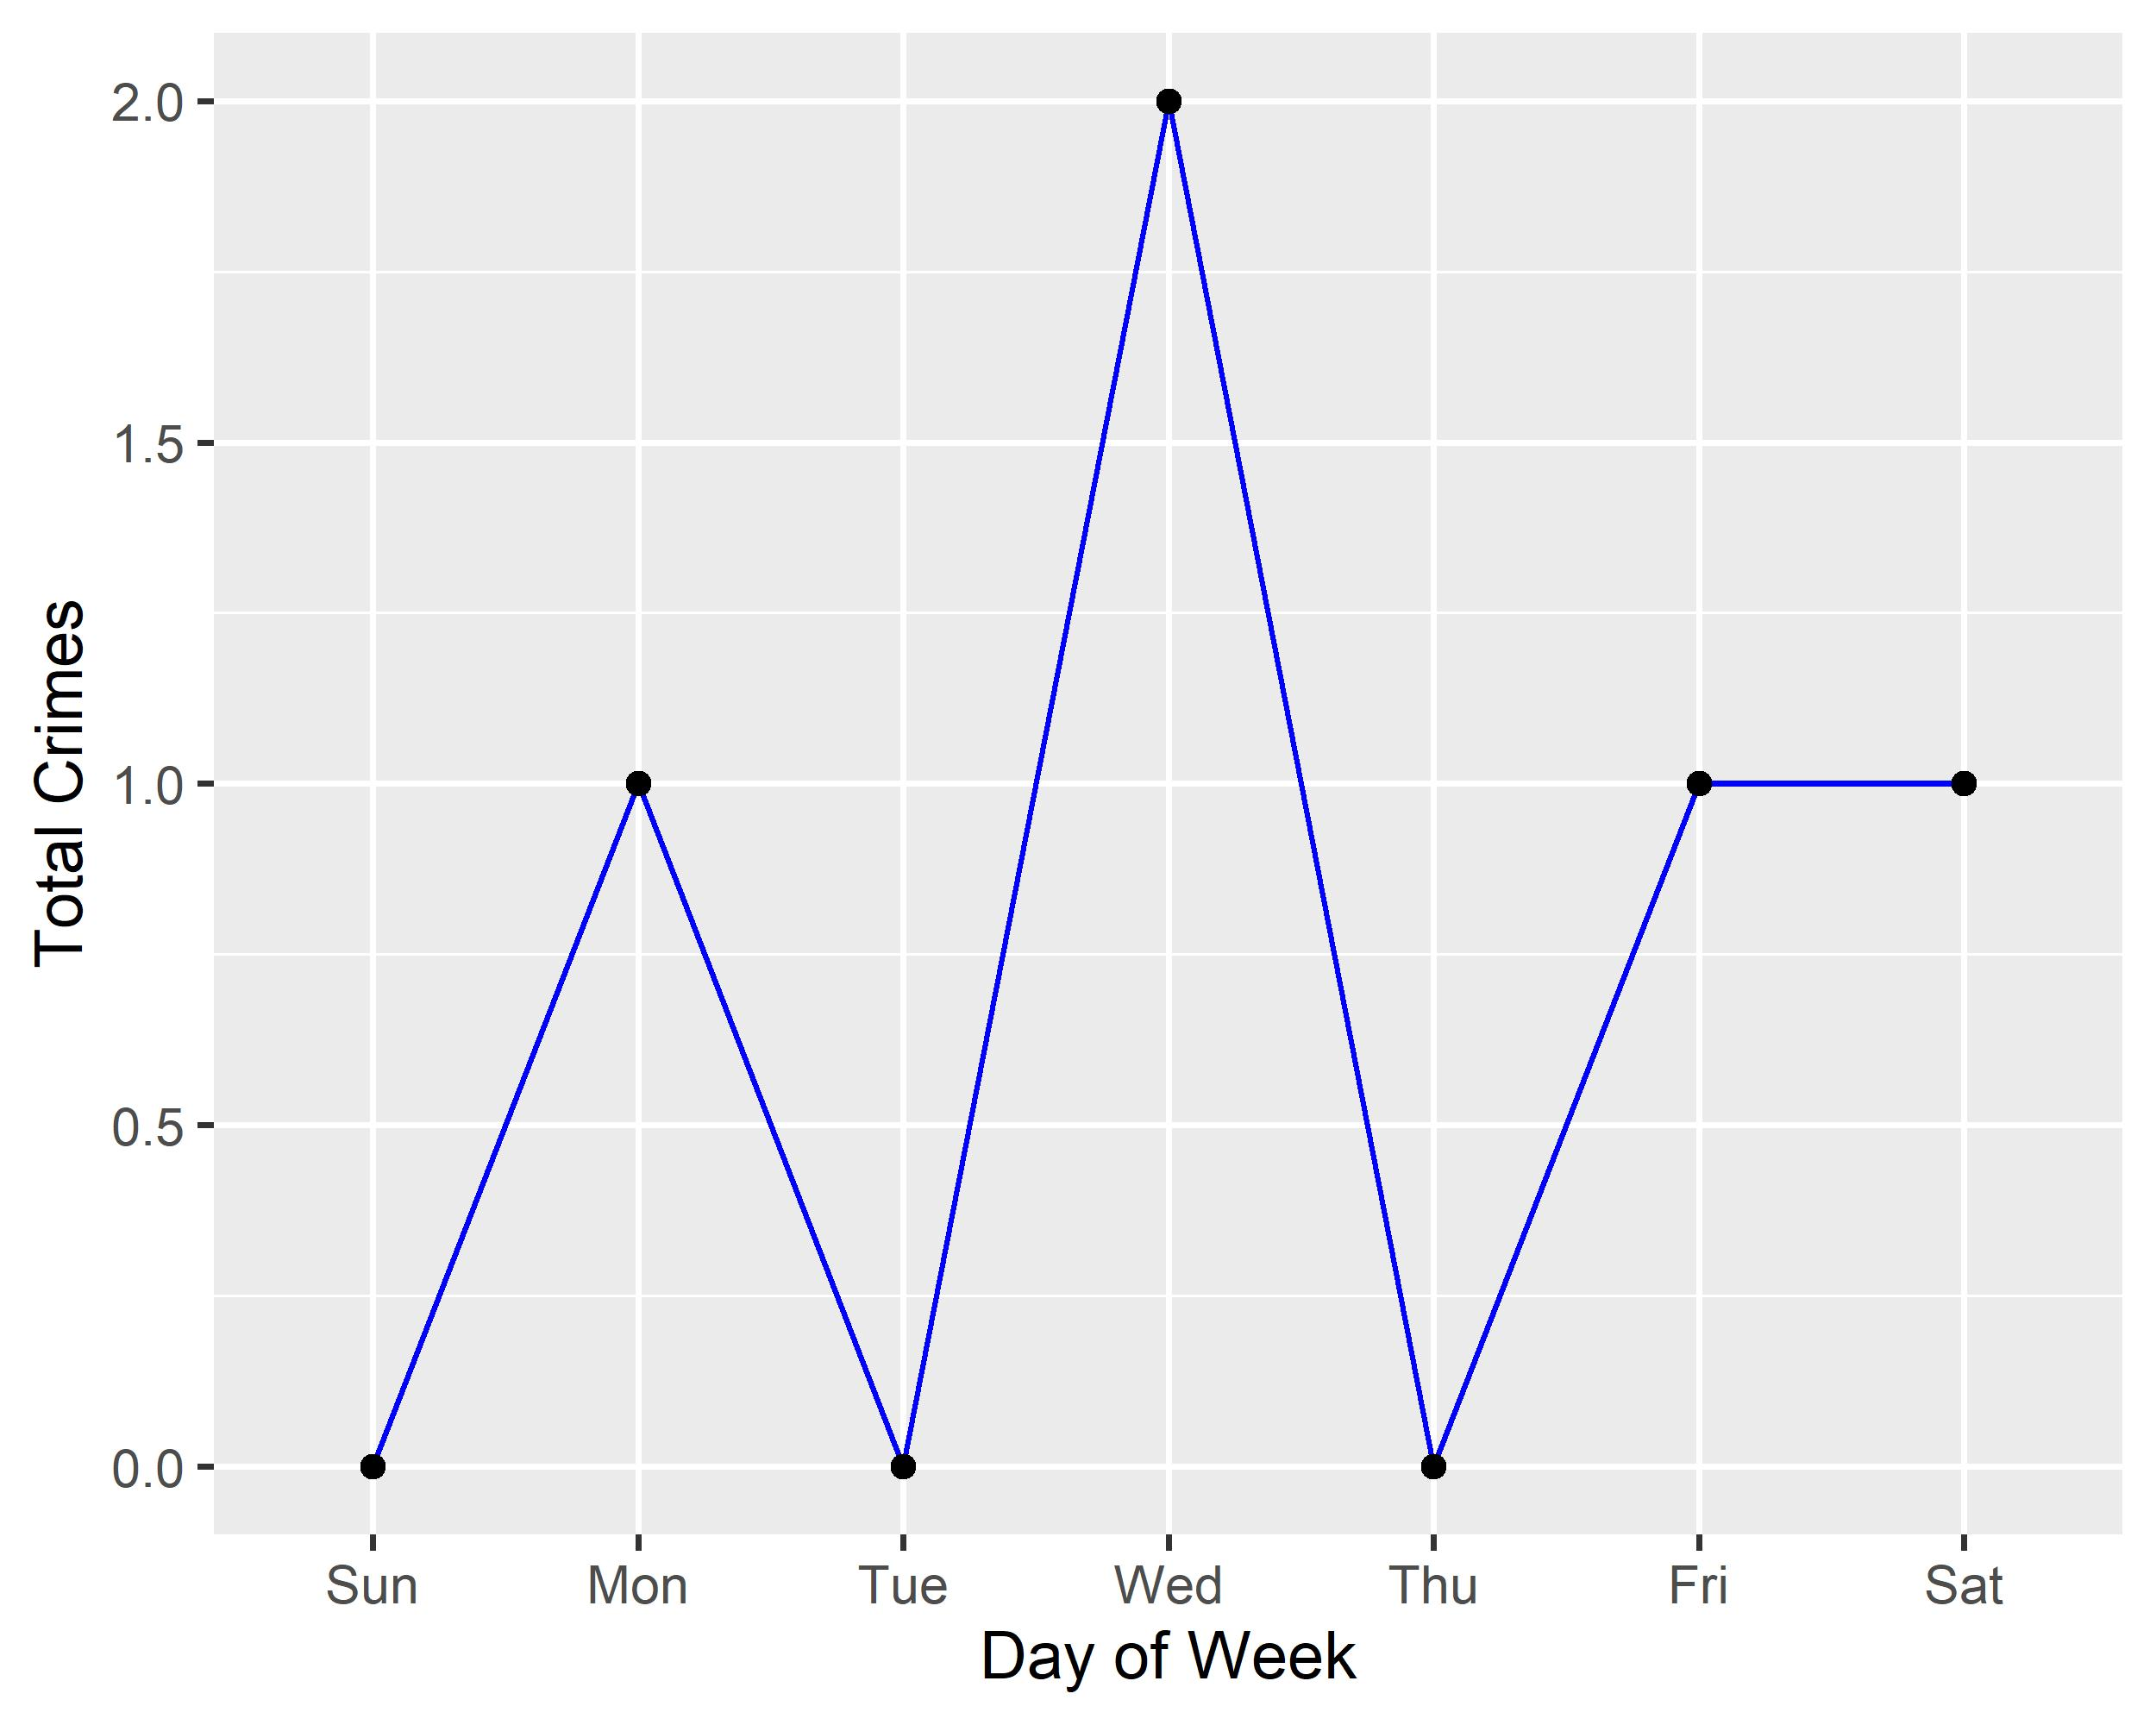
Lewis Place: Total Crimes by Days of the Week

Slide 42

Lewis Place: Crimes by Time of Day

Slide 43
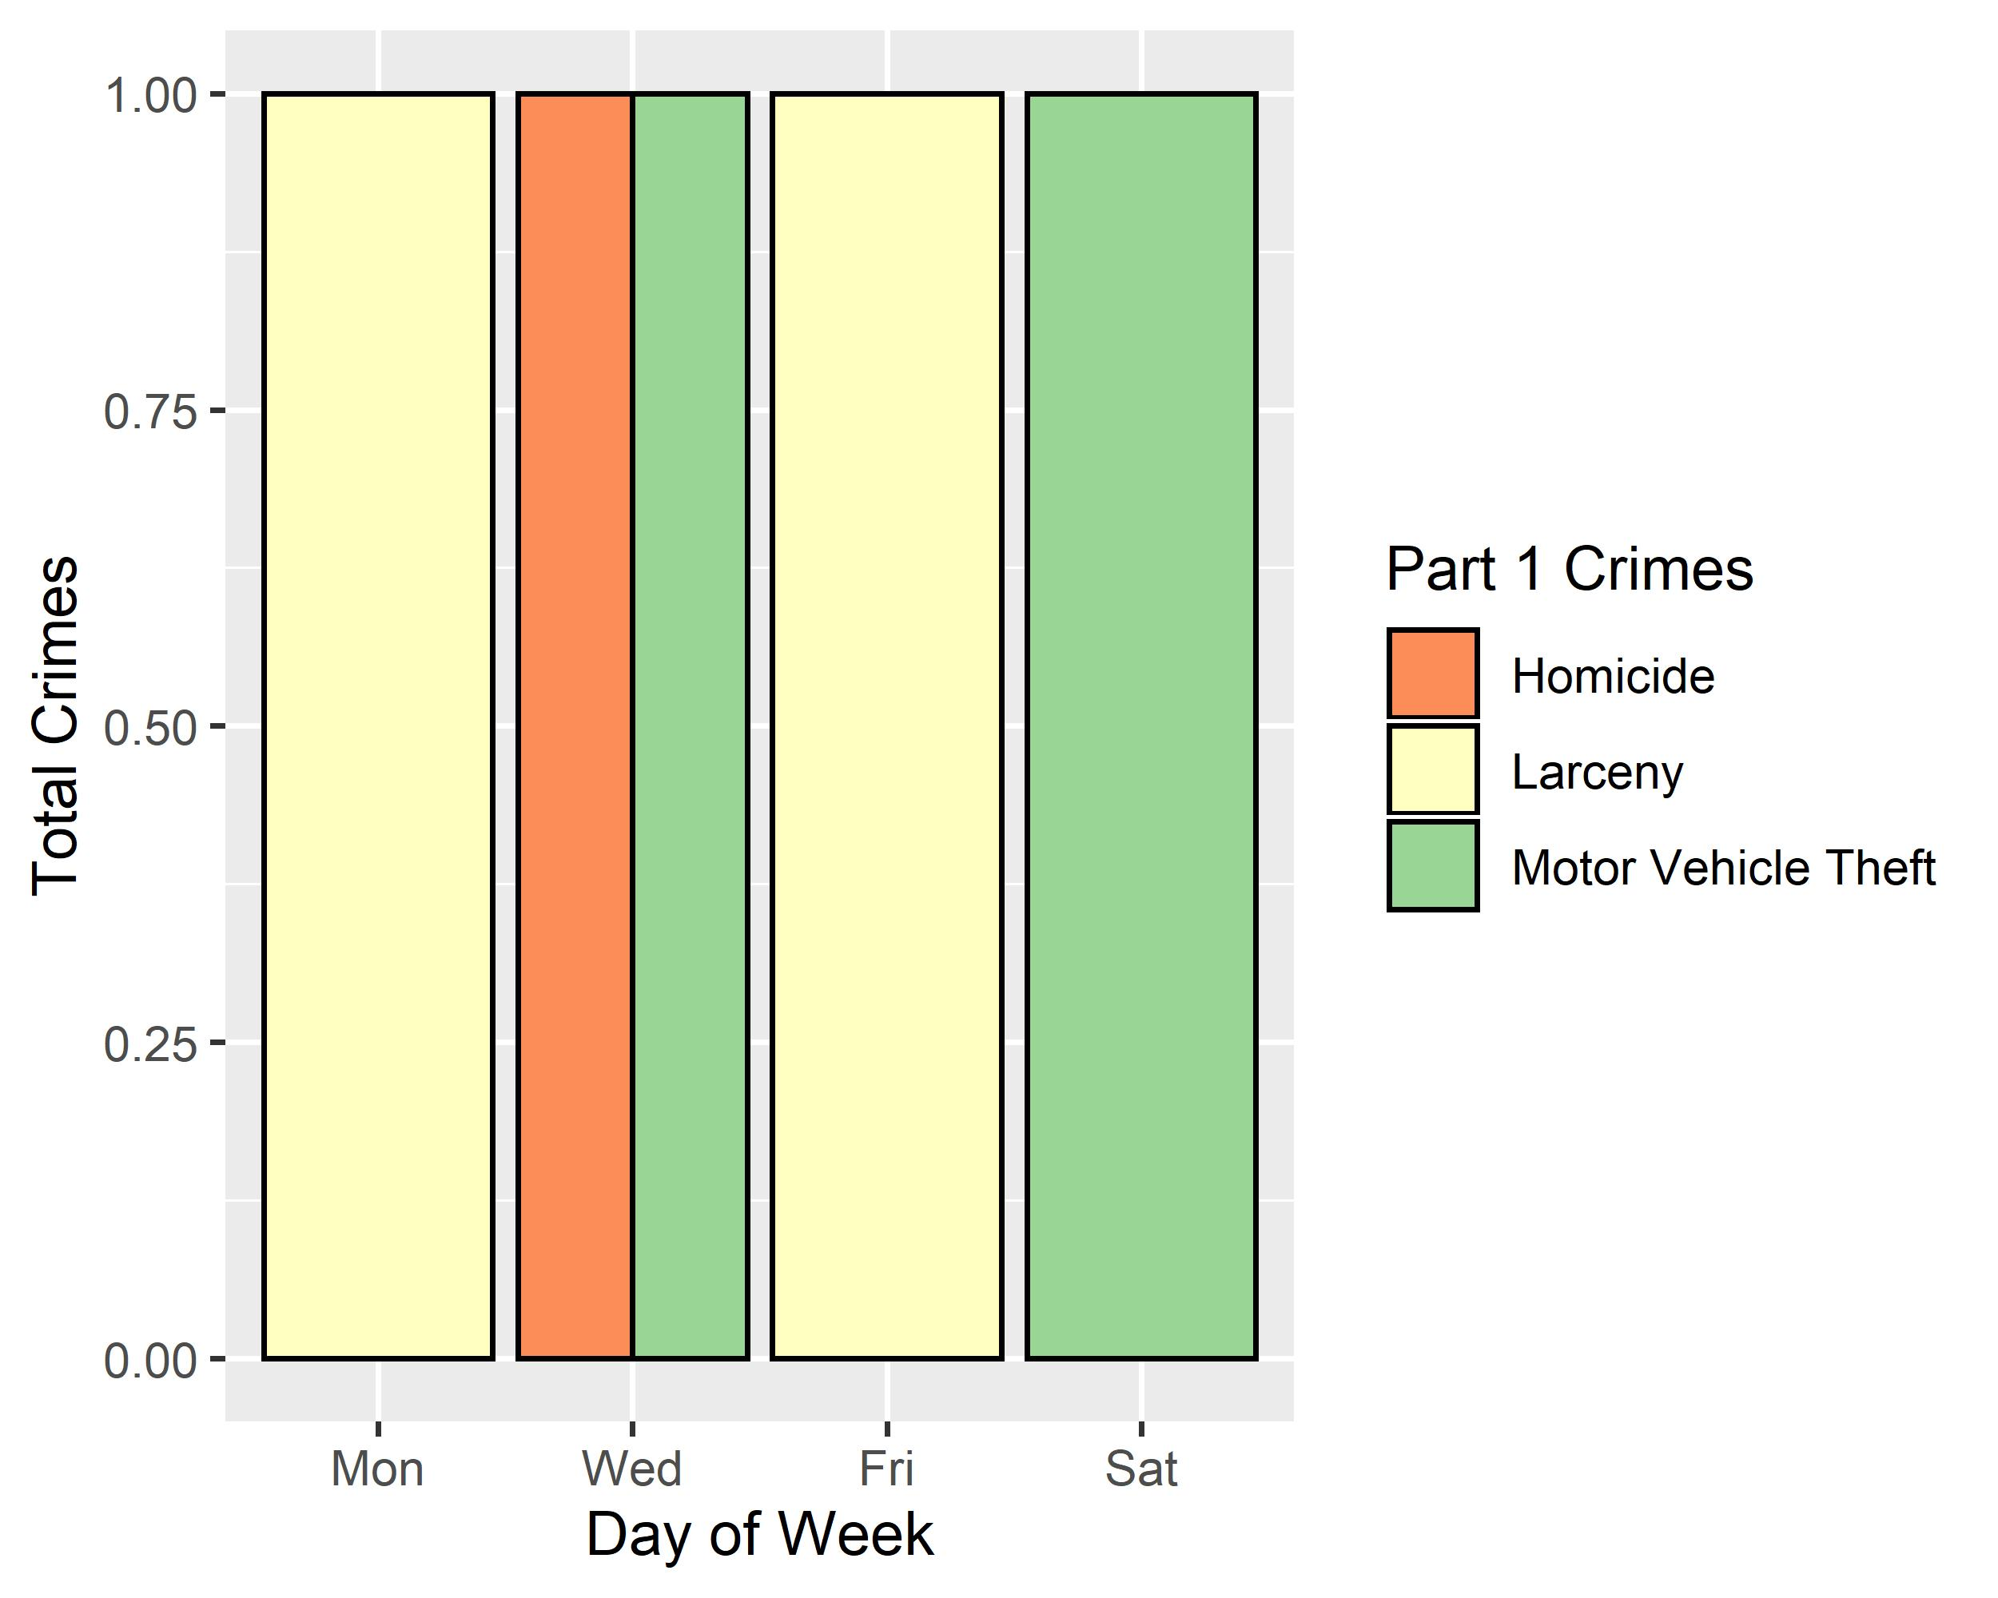
Lewis Place: Crimes by Day & Category

Slide 44
Vandeventer: Neighborhood Detail
Appendix 4

Slide 45
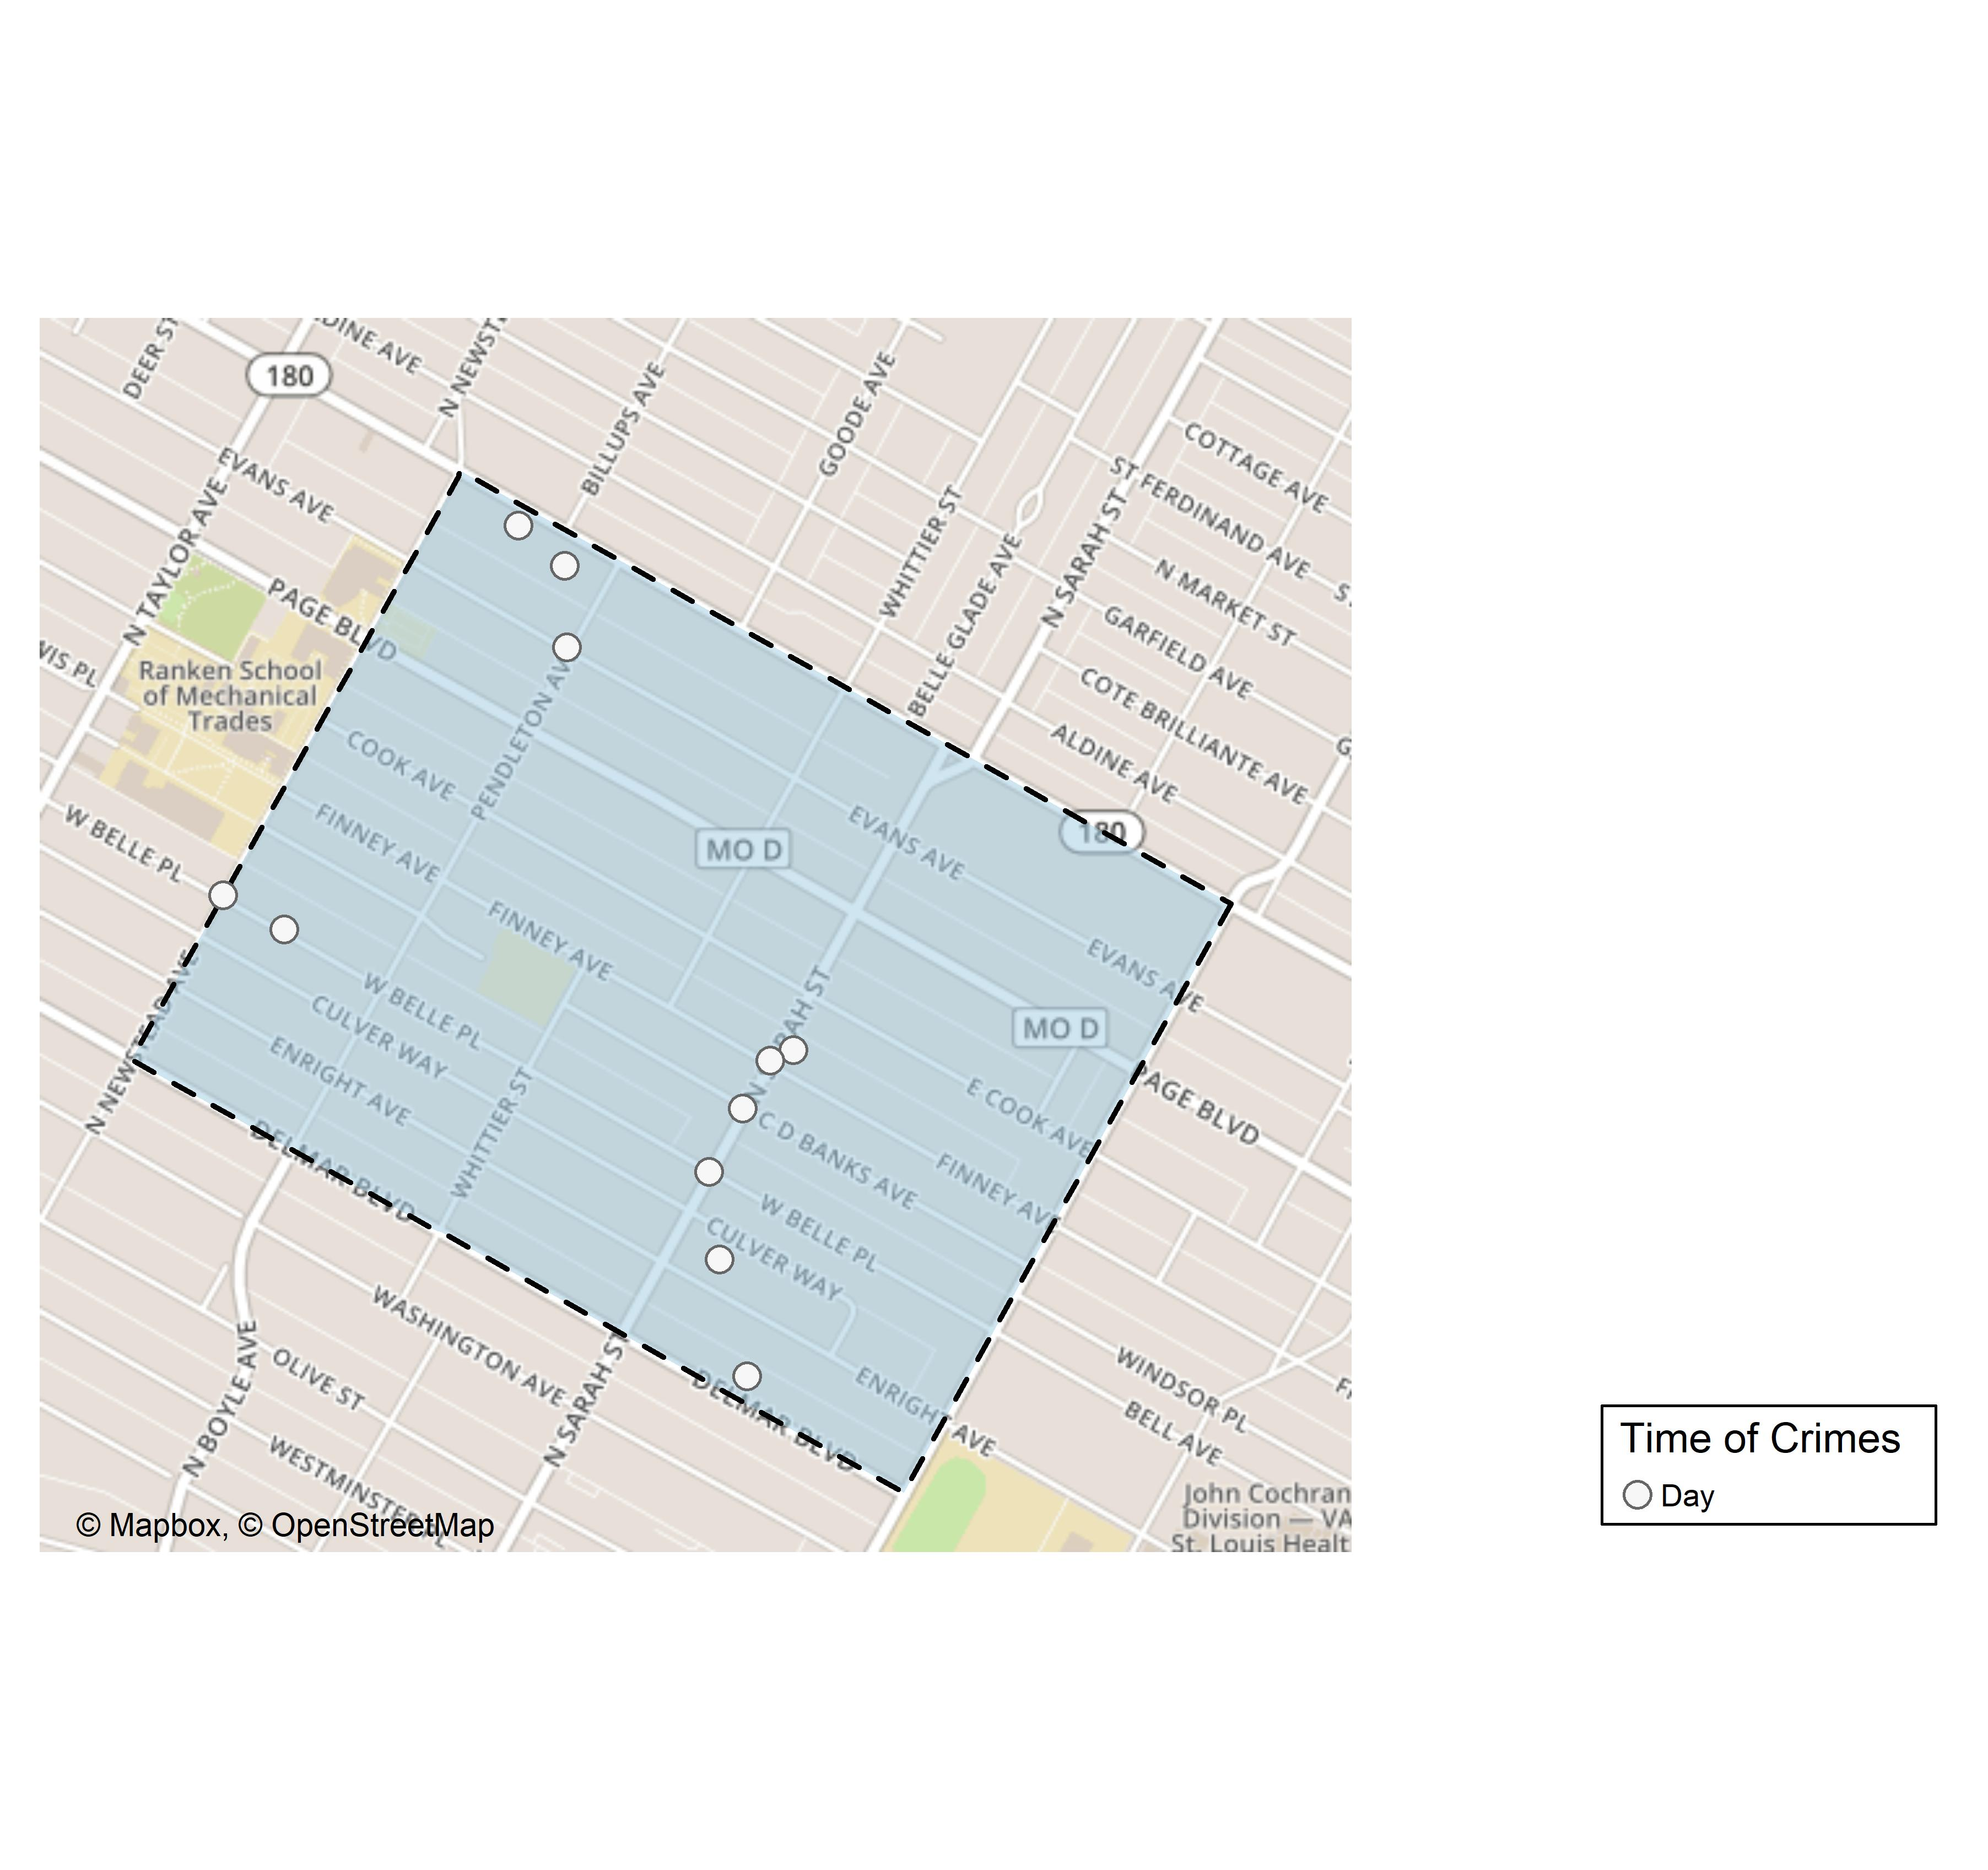
Vandeventer: Time of Crimes Map

Slide 46
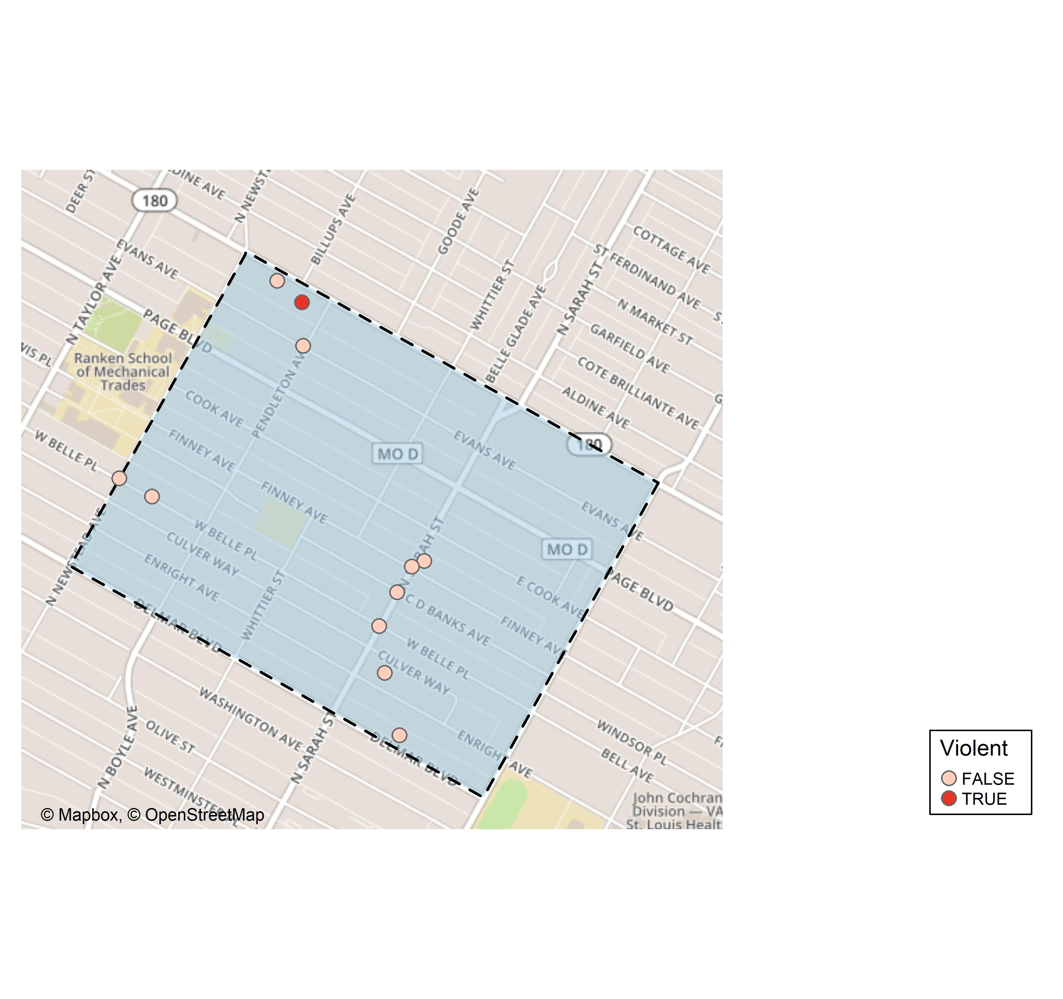
Vandeventer: Violent Crime Map

Slide 47
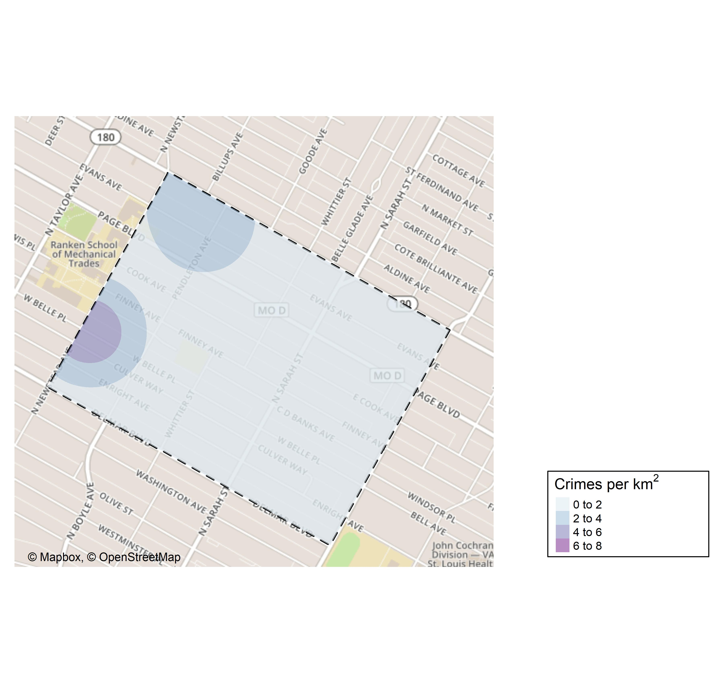
Vandeventer: Crime Density Map

Slide 48
Vandeventer: Larceny Breakdown
Day of the Week | Number of Crimes
Sun | 2
Tue | 1
Thu | 2
Fri | 1
Sat | 2
Total | 8
Time of Day | Number of Crimes
Day | 8
Total | 8
Type of Larceny | Number of Crimes
All Other | 3
From Building | 1
From Motor Vehicle | 2
Motor Vehicle Parts | 2
Total | 8
Monetary | Number of Crimes
$500 - $24,999 | 3
Under $500 | 5
Total | 8

Slide 49
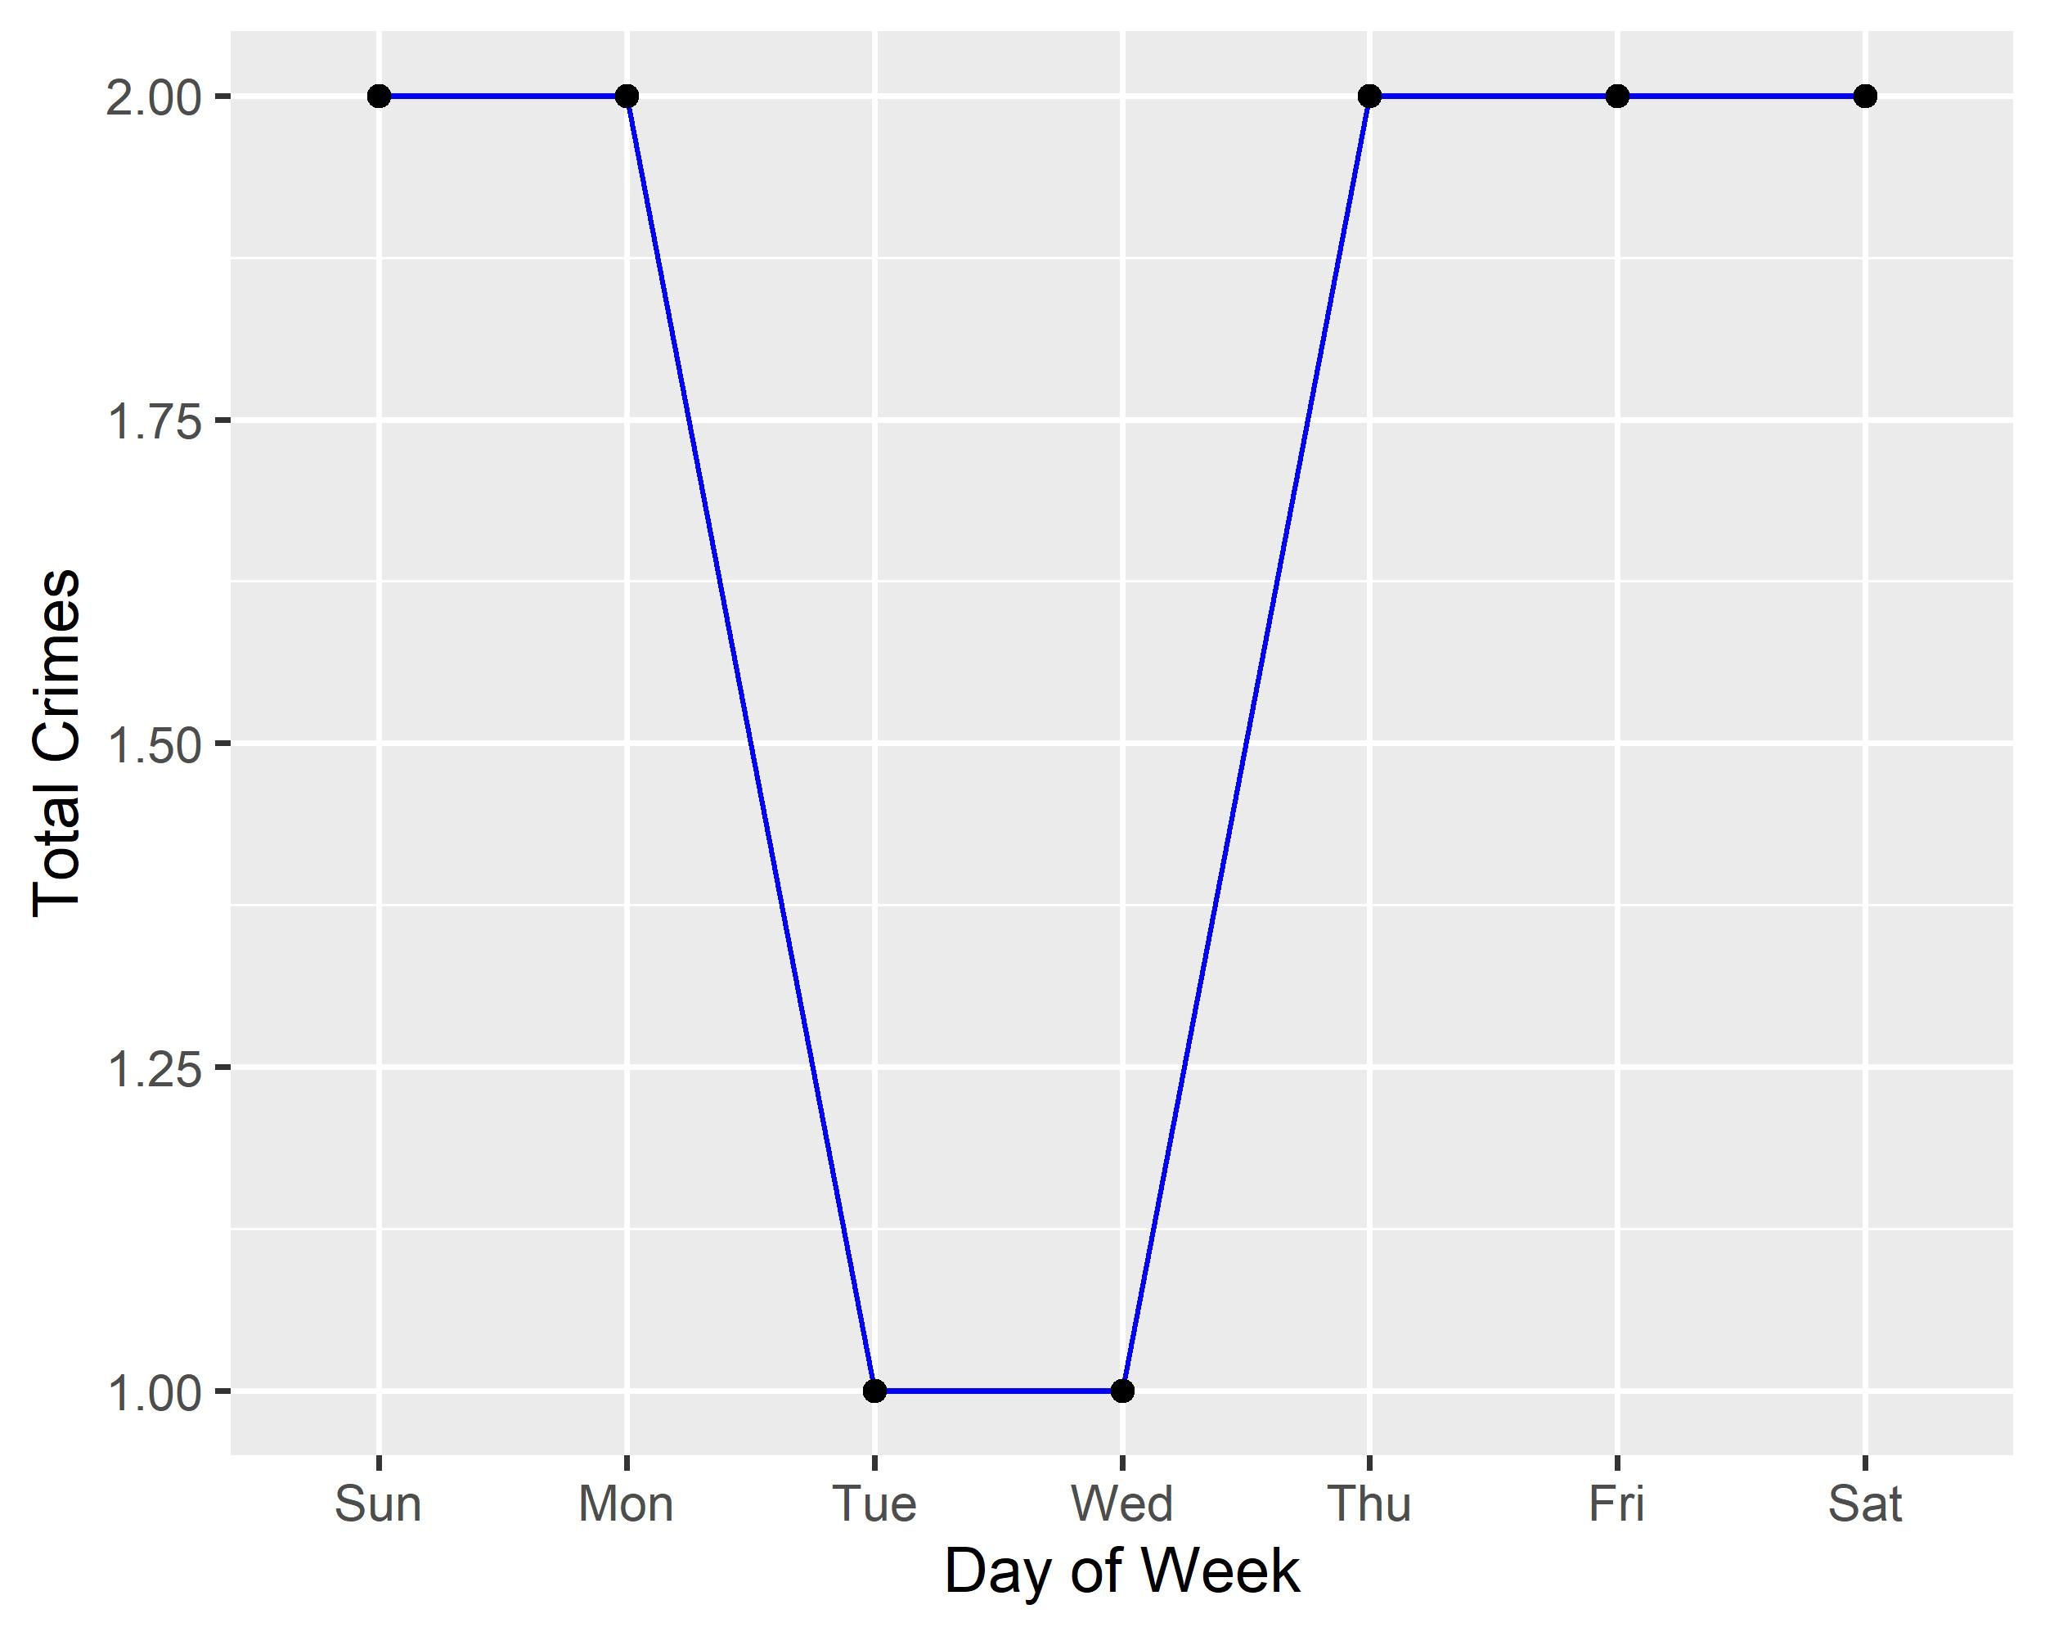
Vandeventer: Total Crimes by Days of the Week

Slide 50
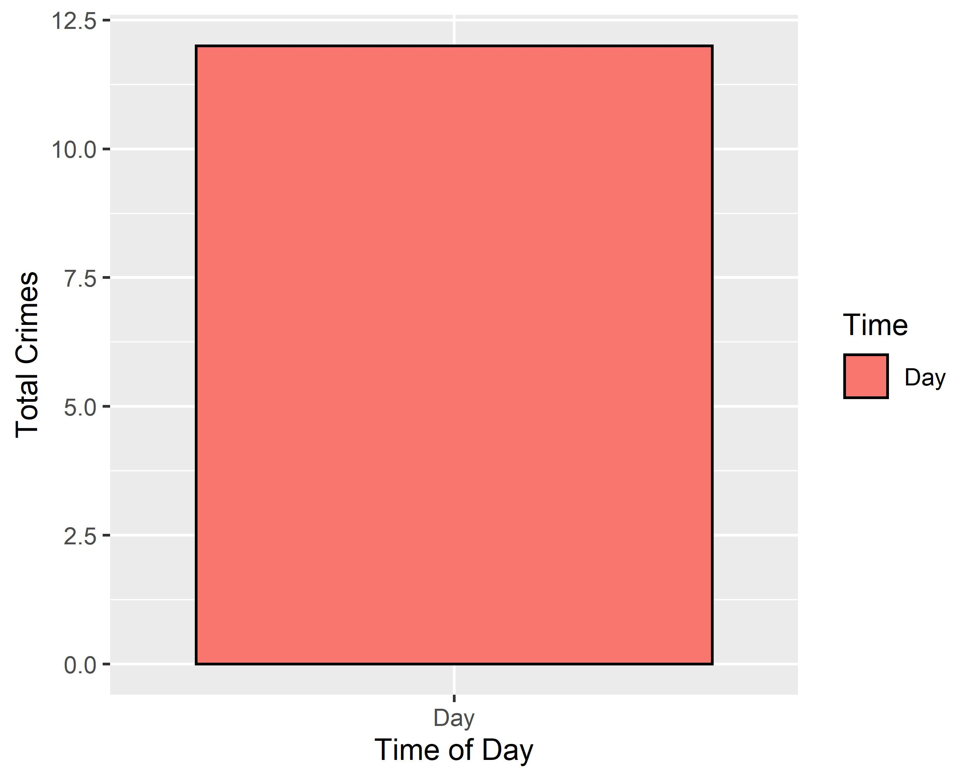
Vandeventer: Crimes by Time of Day

Slide 51
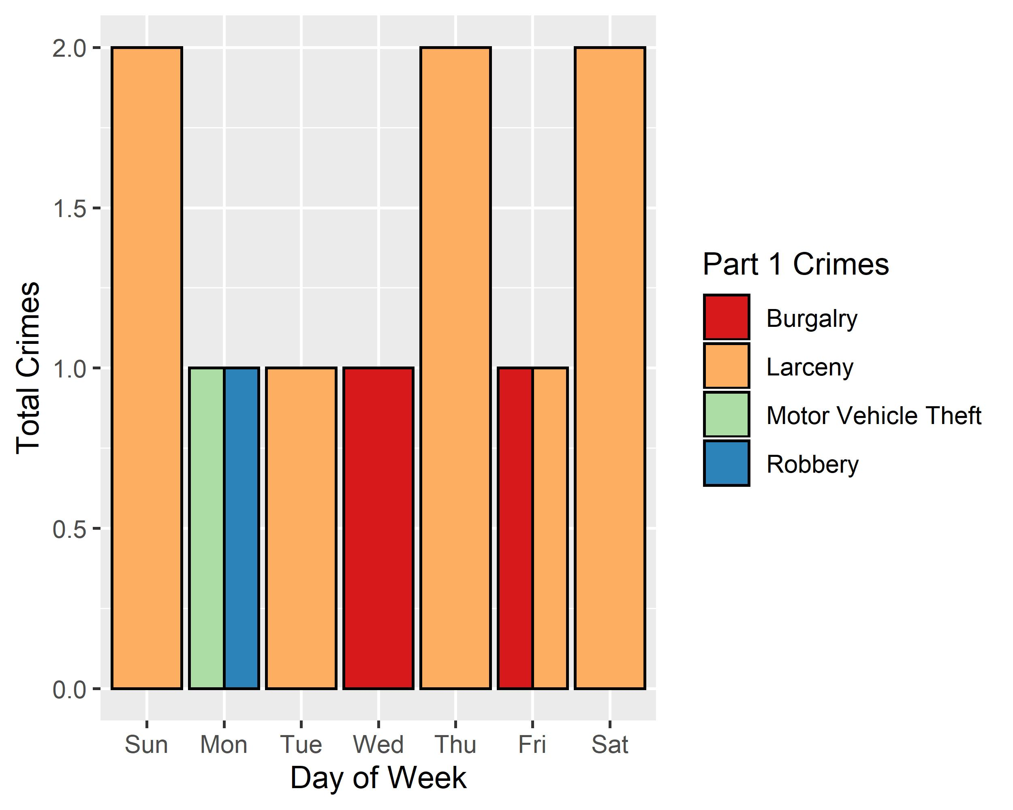
Vandeventer: Crimes by Day & Category

